Slide 1
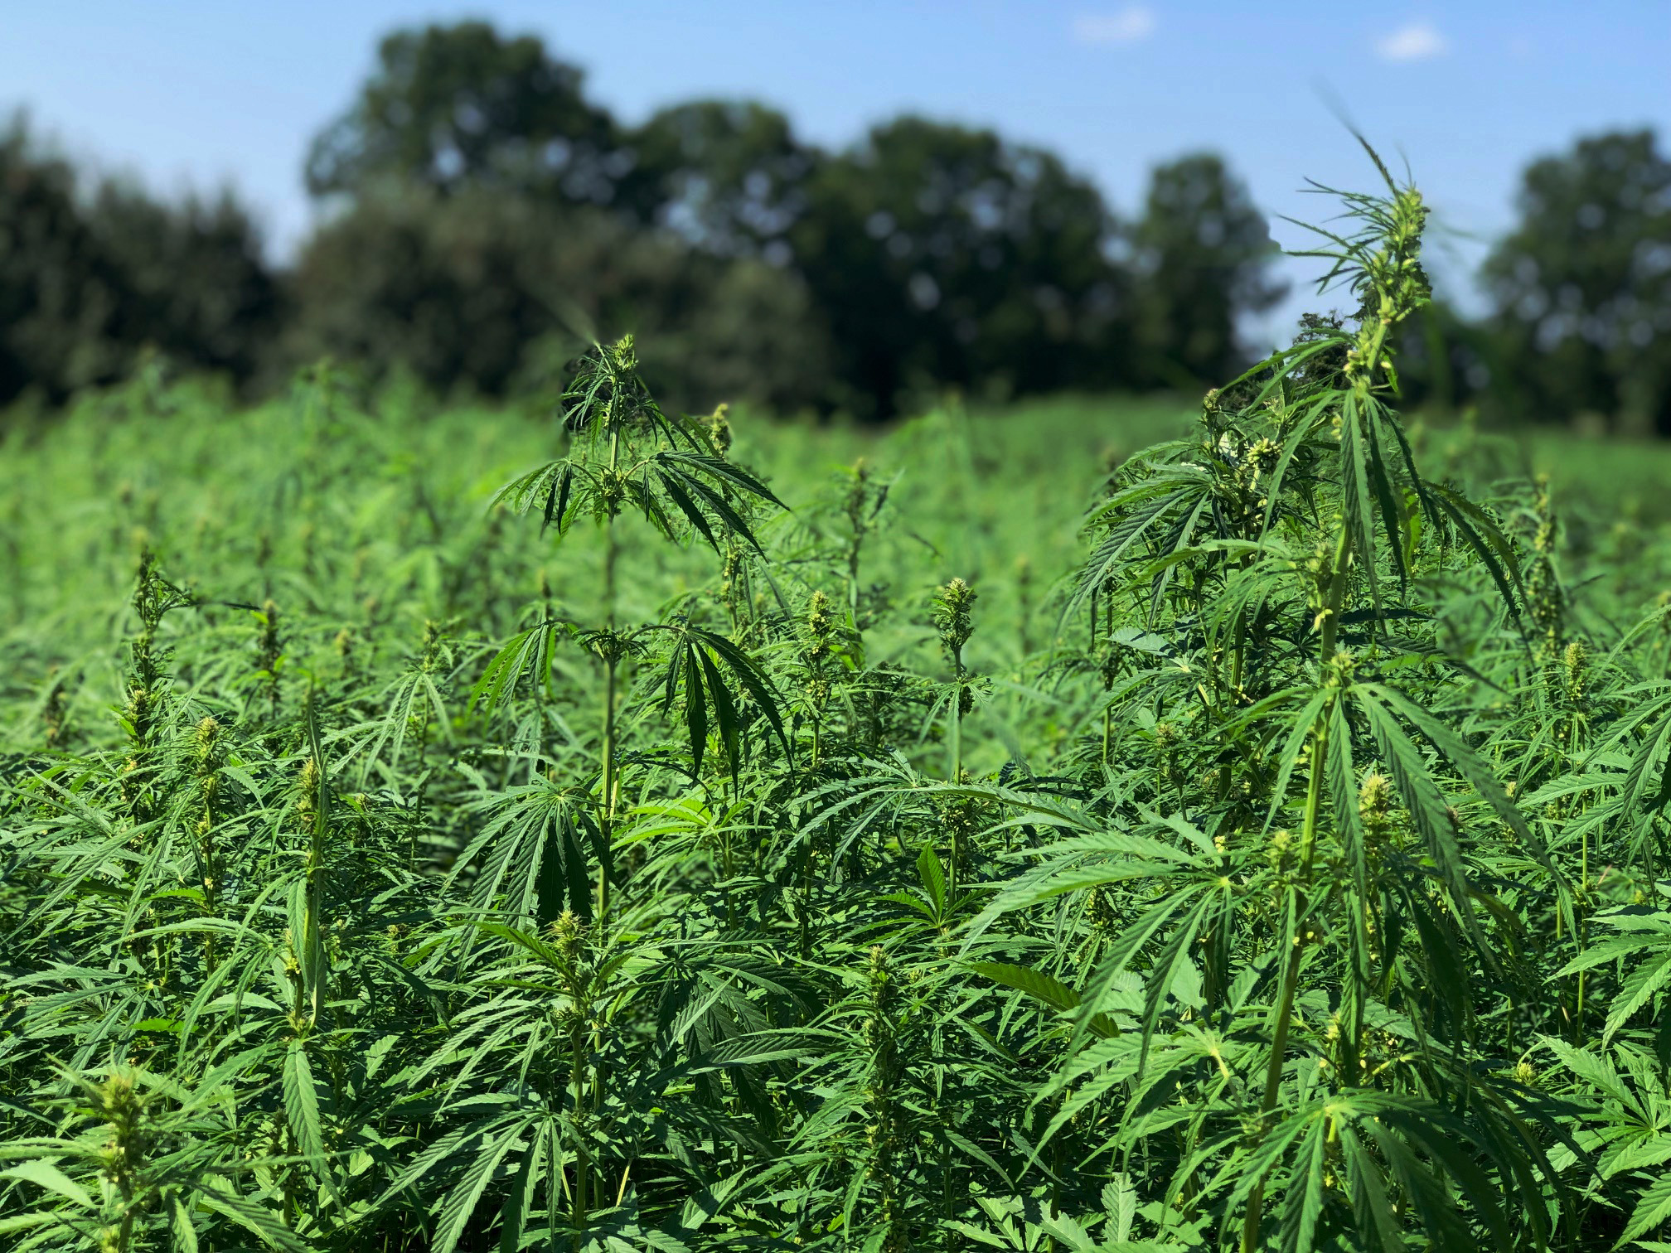
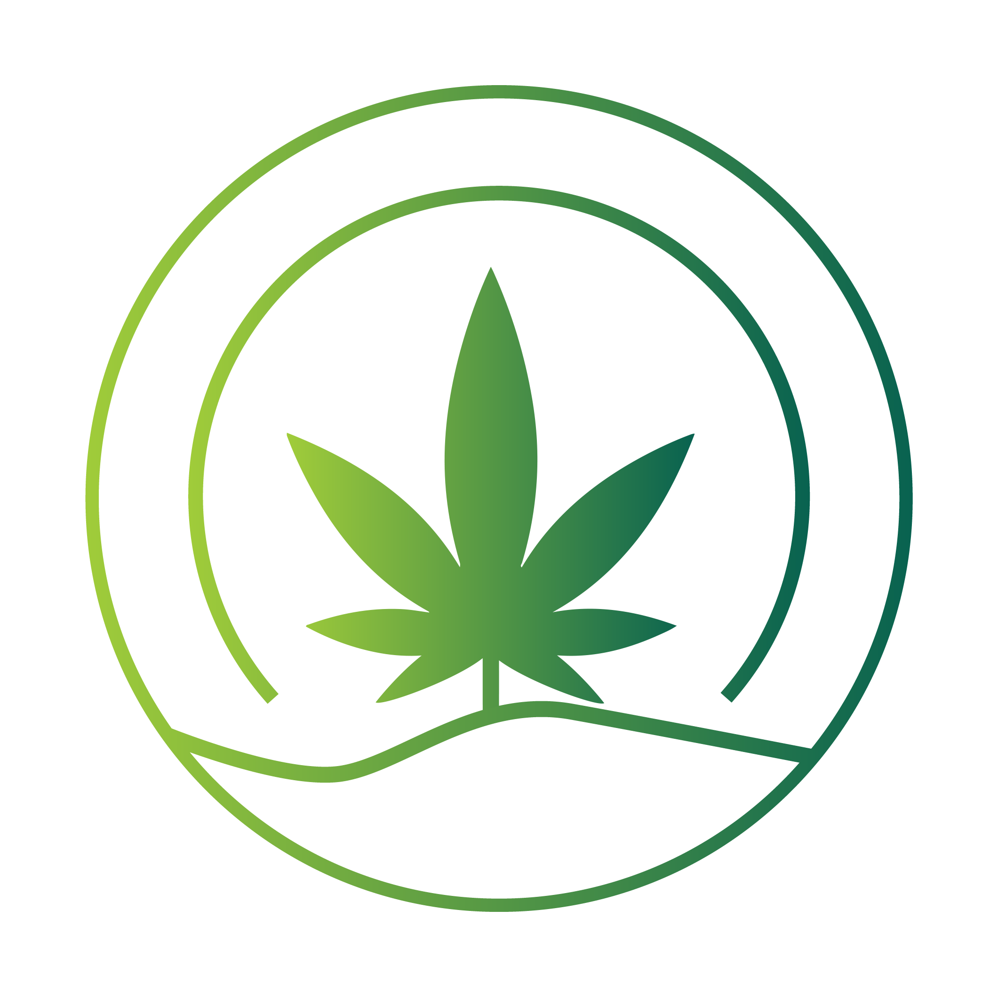
2024 OSU HEMP WORKSHOP
Growing Hemp for the Future:
OPPORTUNITIES FOR TEXTILES
2024 OSU Hemp Workshop

Slide 2

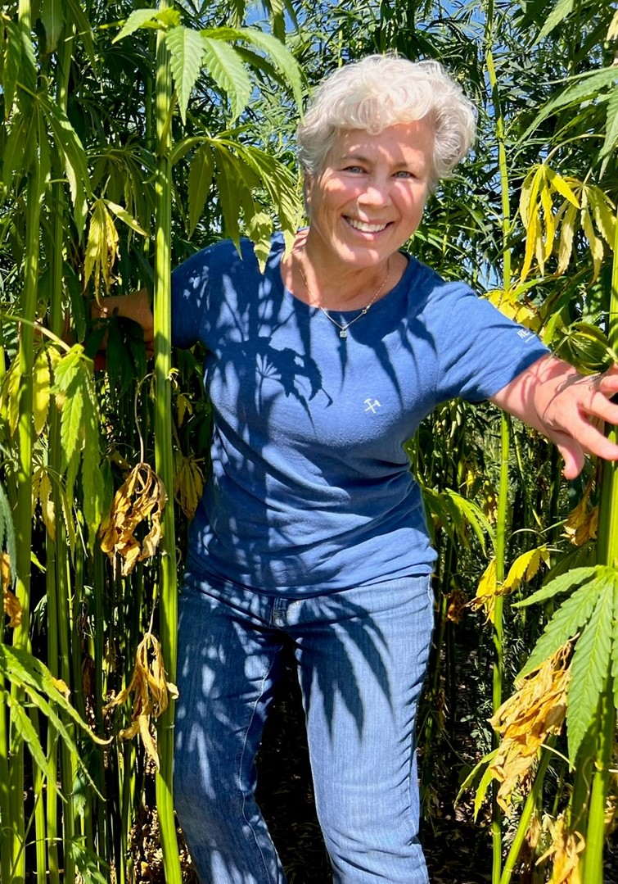
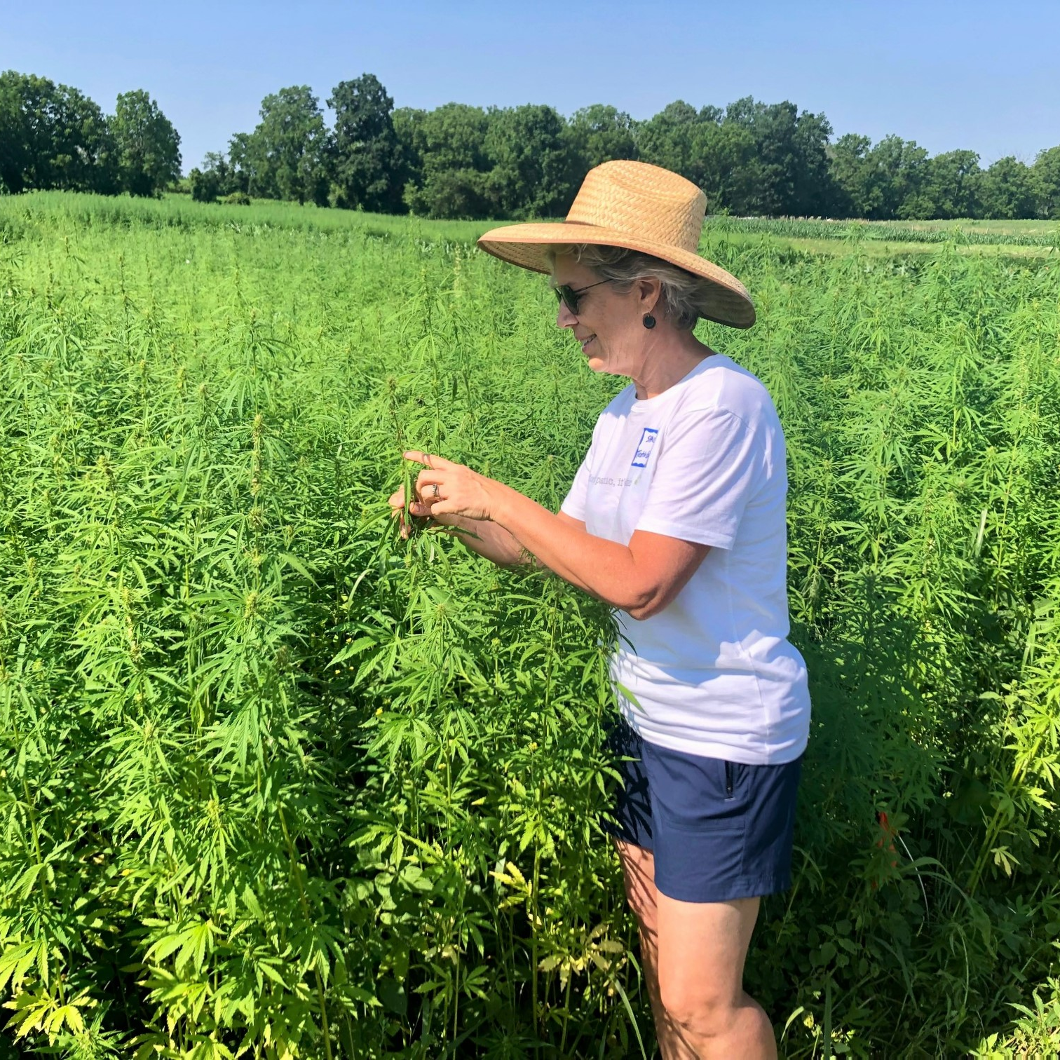
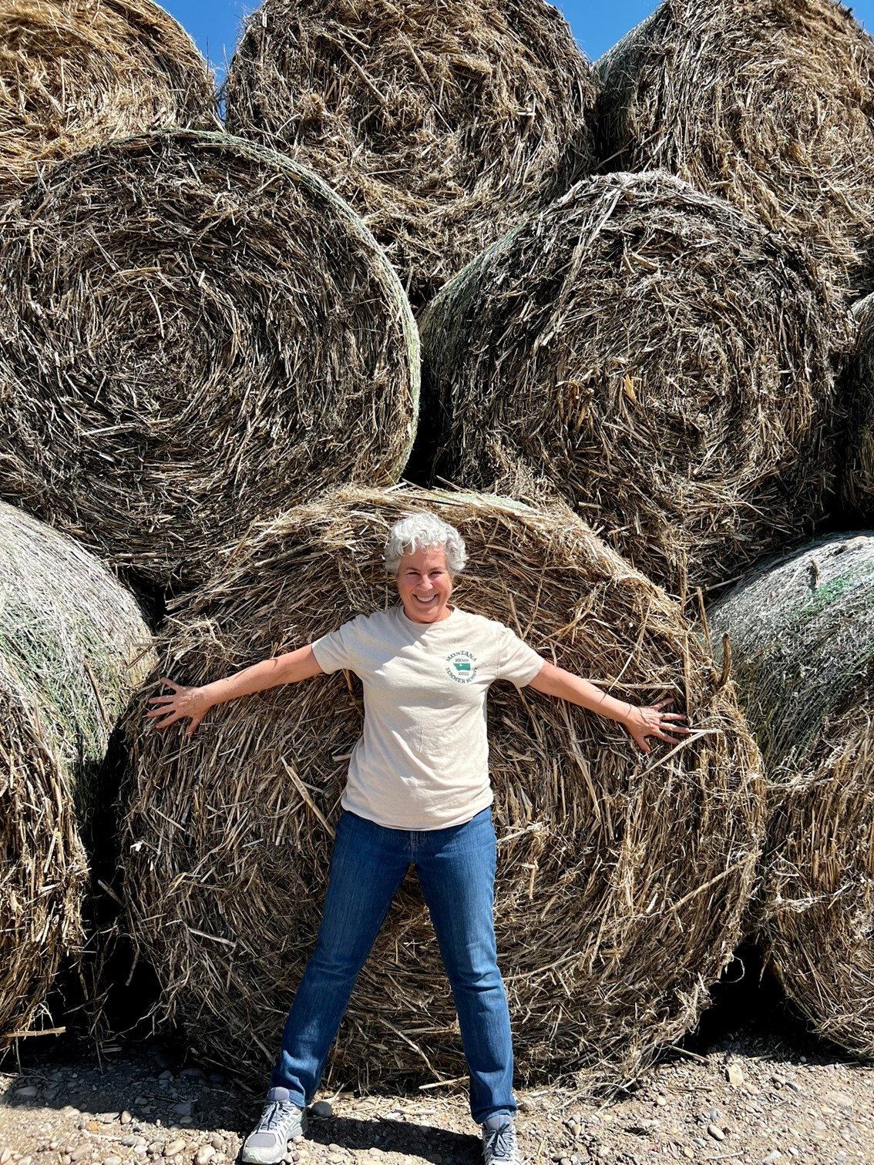
2024 OSU HEMP WORKSHOP
SANDRA MARQUARDT
ON THE MARK CONSULTING
Notes:
SM: Note these pics were taken on Montana, North Carolina, and Pennsylvania farms.

Slide 3
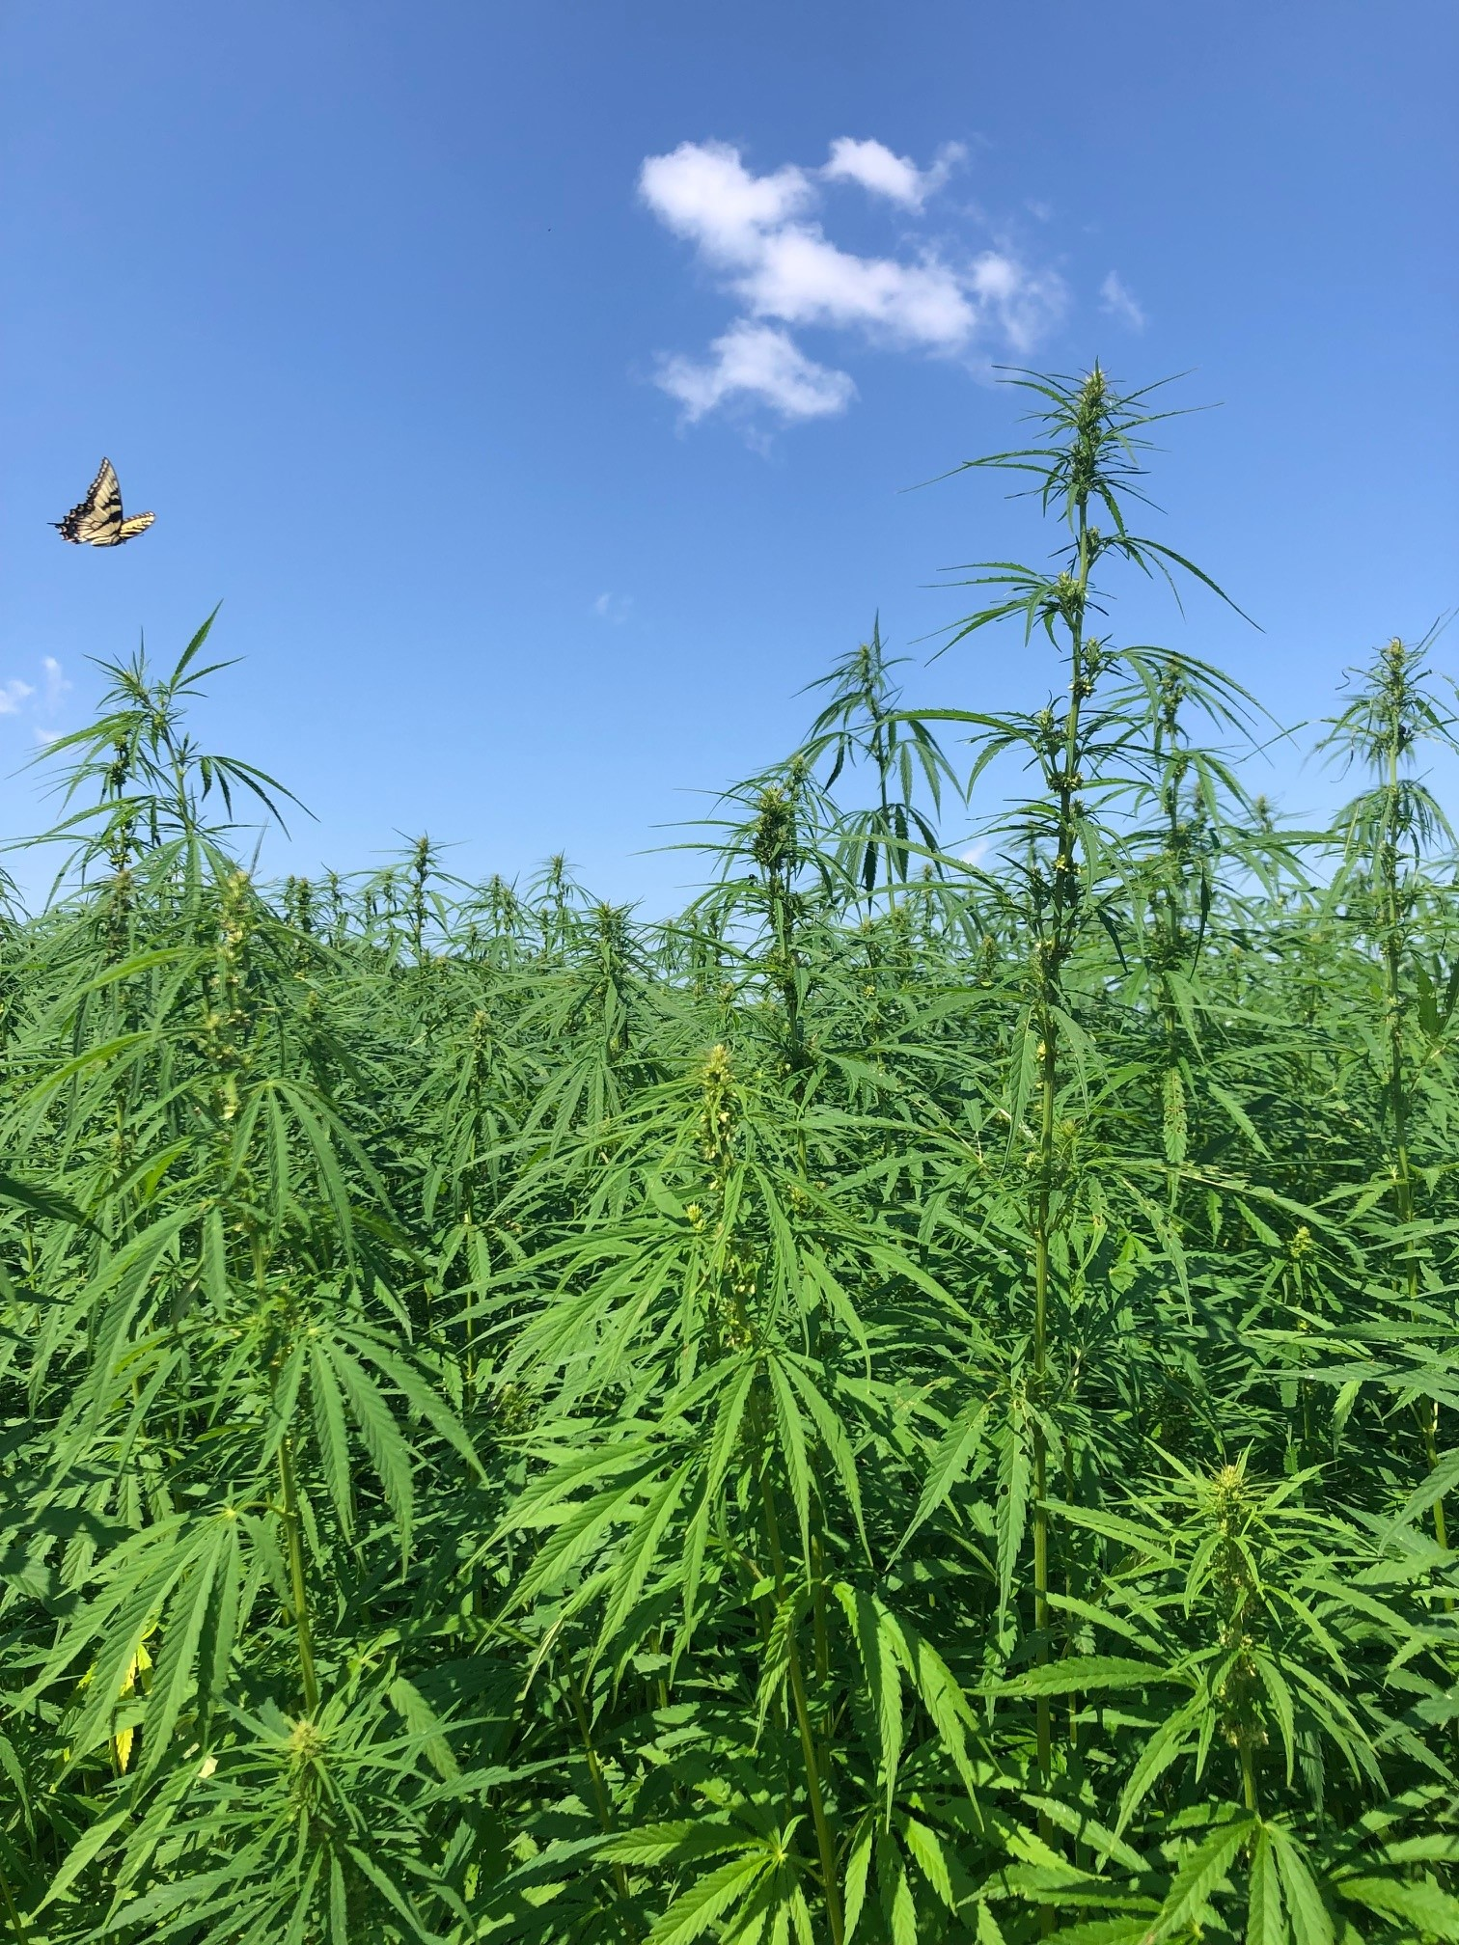

TODAY’S PRESENTATION
2024 OSU HEMP WORKSHOP
OVERVIEW
of industrial fiber hemp and use in the textile sector
WHERE AND HOW FIBER IS PRODUCED: Findings from Textile Exchange’s “Growing Hemp for the Future”
OBSTACLES,
CONSIDERATIONS, AND OPPORTUNITIES for the textile sector
RECOMMENDATIONS

Slide 4
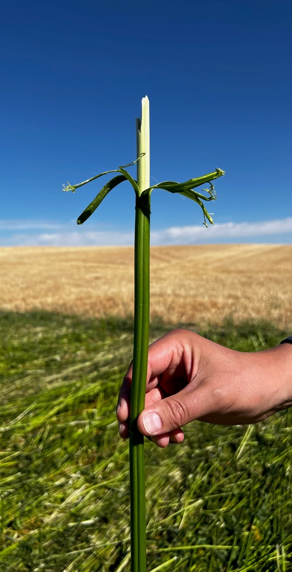
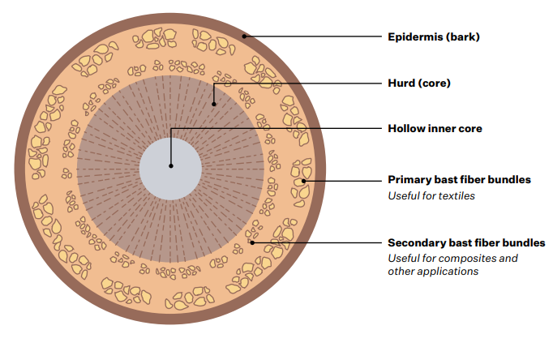
WHAT IS INDUSTRIAL FIBER HEMP?
2024 OSU HEMP WORKSHOP
Hemp is a bast fiber in the Cannabaceae family.
Industrial hemp grown for fiber is an annual broadleaf plant that grows quickly up to 3–5 meters (approximately 10–15 feet).
The fiber-producing part of the plant is made up of strands that run the length of the plant, surrounding the “hurd,” or woody core of the stem, and covered by a thin, gummy varnish that creates the delicate “bark” of the plant.
Pectin adheres the fibers to the air-filled, woody core and lignin binds the fibers in bundles along the stalk.
Photo: Sandra Marquardt
Image: Textile Exchange

Slide 5
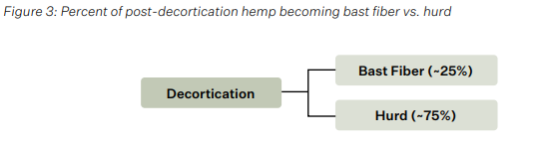
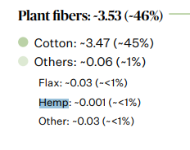
MAKE-UP OF INDUSTRIAL HEMP
2024 OSU HEMP WORKSHOP
Global fiber production in 2022
(in million tonnes and % of global fiber production)
Percent of post-decortication hemp
becoming bast fiber vs. hurd
Images: Textile Exchange
This results in tall, slender plants with long, strong bast fibers (~25%) on the outside and the shorter woody hurd fibers – or particles - (~75%) in the stalk.
To-date, hemp as a raw material for textiles is made from bast fiber. The hurd has primarily gone to animal bedding, building materials, and the like.
In 2022, hemp represented less than 1% of fiber and raw materials uptake by the global textile sector – but was the third most reported plant fiber (after cotton and flax).
Notes:
Plant Fibers figure: https://textileexchange.org/app/uploads/2023/11/Materials-Market-Report-2023.pdf
Percent figure: Growing Hemp for the Future

Slide 6
2024 OSU HEMP WORKSHOP
GROWING HEMP FOR THE FUTURE:
A global fiber guide
Before we can make textiles, we need to know more about where and how hemp is produced.
2023 Textile Exchange Report - Growing Hemp for the Future identified:
  Benefits and concerns re the crop and its production
  The status of pesticide registrations on fiber hemp in key regions
  Key production regions
  Applicable production standards in line with Textile Exchange Climate+ goals.

Slide 7
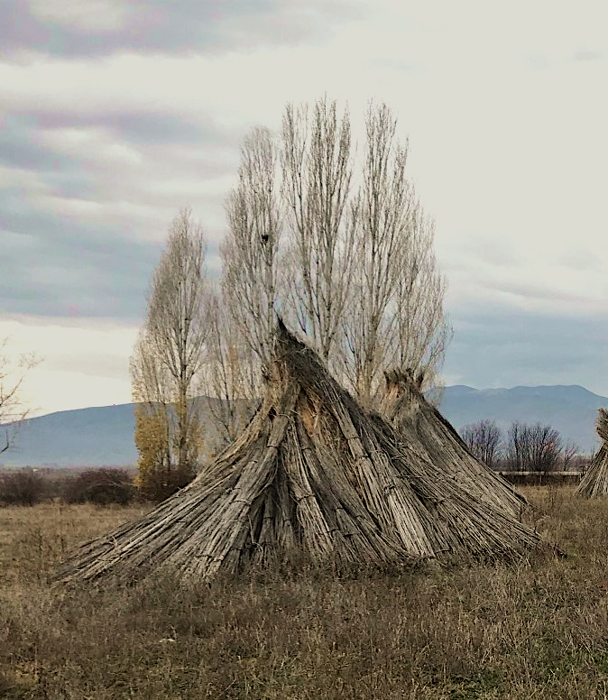
2024 OSU HEMP WORKSHOP
APPROACH AND
DISCLAIMERS
Data re hemp production and definitions are sometimes inaccurate, incomplete, and even conflicting.
This was not an exhaustive effort to research every country’s production; we used FAO (>Eurostat) as well as USDA and Turkish government data.
FAOSTAT does not include hemp-related data for numerous fiber hemp-growing countries, including the US. Some of its information – regarding North Korea, for example – is based on estimates.
We did not include Canada as they only provide hemp grain figures.
Photo: Omur Suner

Slide 8
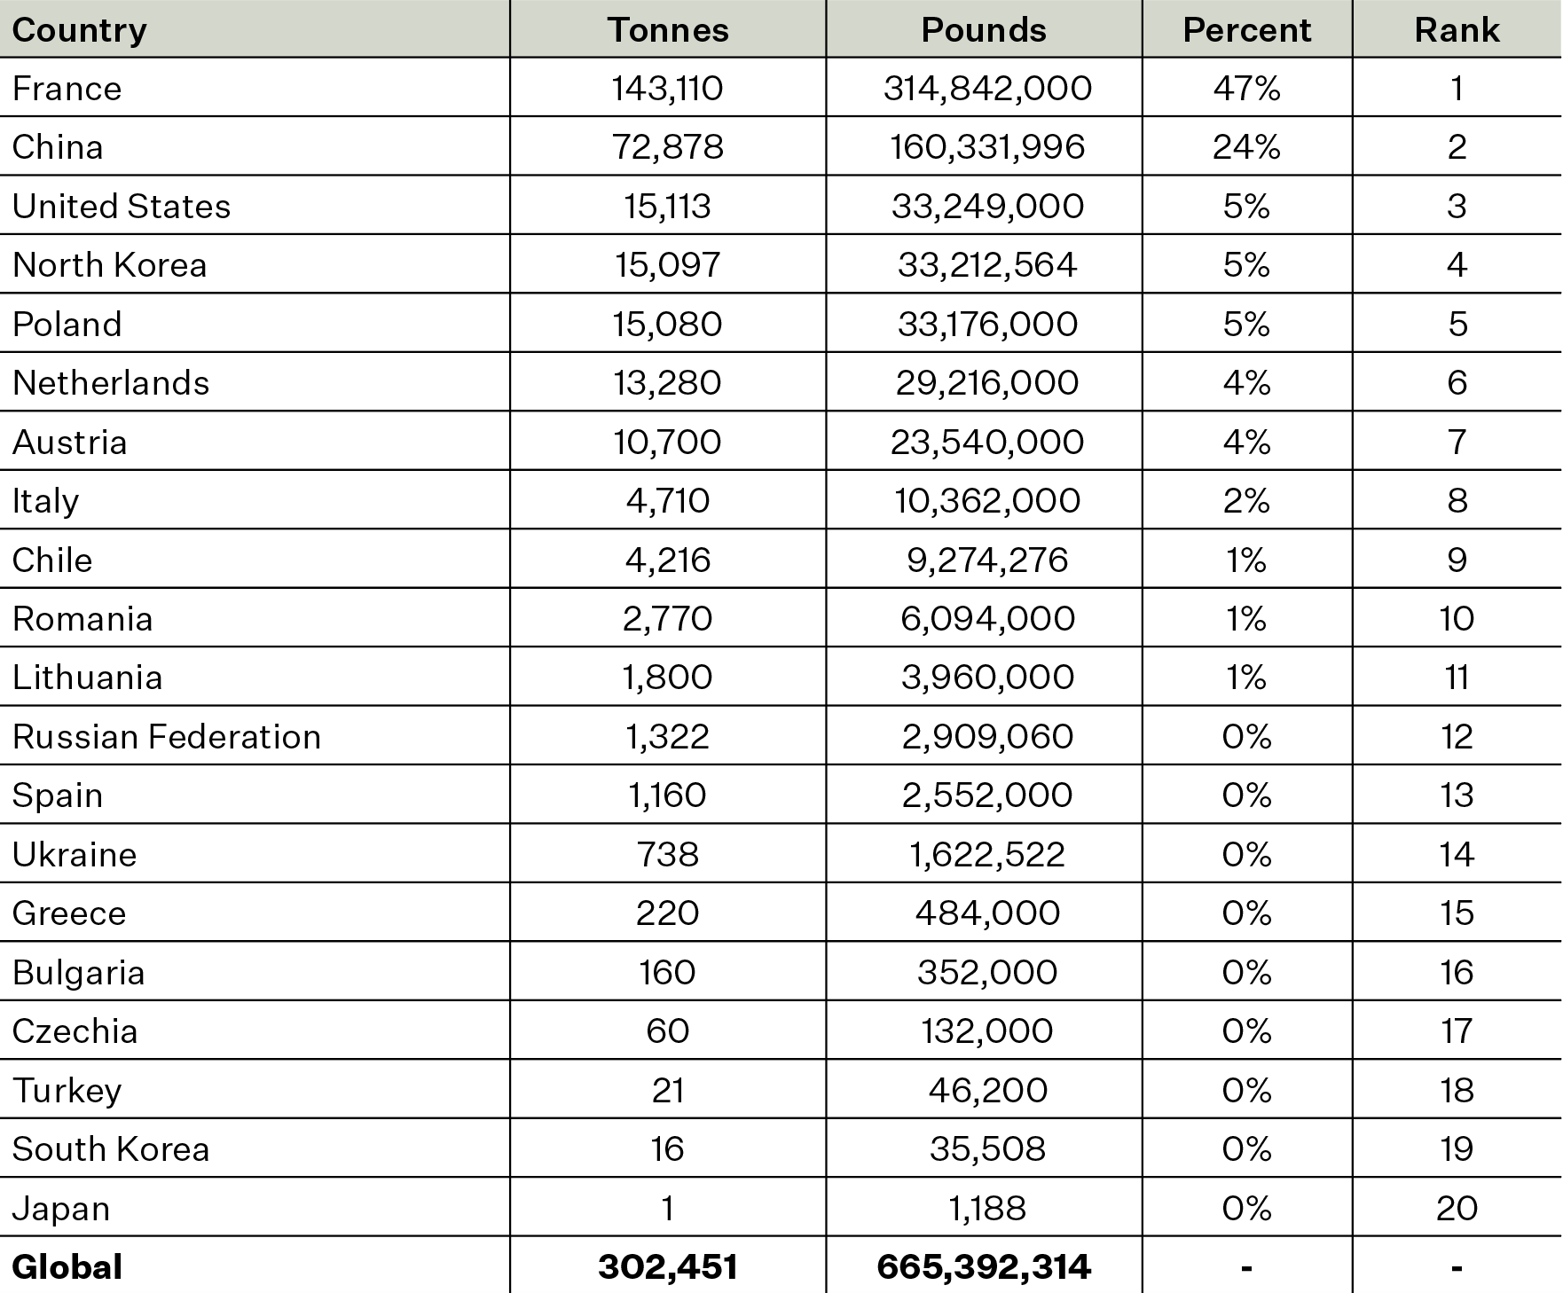
GLOBAL FIBER
HEMP
PRODUCTION
(2021)
2024 OSU HEMP WORKSHOP
~665,000 pounds (302,000 tonnes) of fiber hemp were produced in 21 countries in 2021.
The countries were: Austria, Bulgaria, Chile, China, Czechia, Democratic People's Republic of Korea (North Korea), France, Germany, Greece, Italy, Japan, Lithuania, The Netherlands, Poland, Republic of Korea (South Korea), Romania, Russian Federation, Spain, Turkey, Ukraine, and the United States.
Most fiber hemp by volume was grown in five countries: France (47%), China (24%), and the US, North Korea, and Poland, each with approximately 5%.

Slide 9
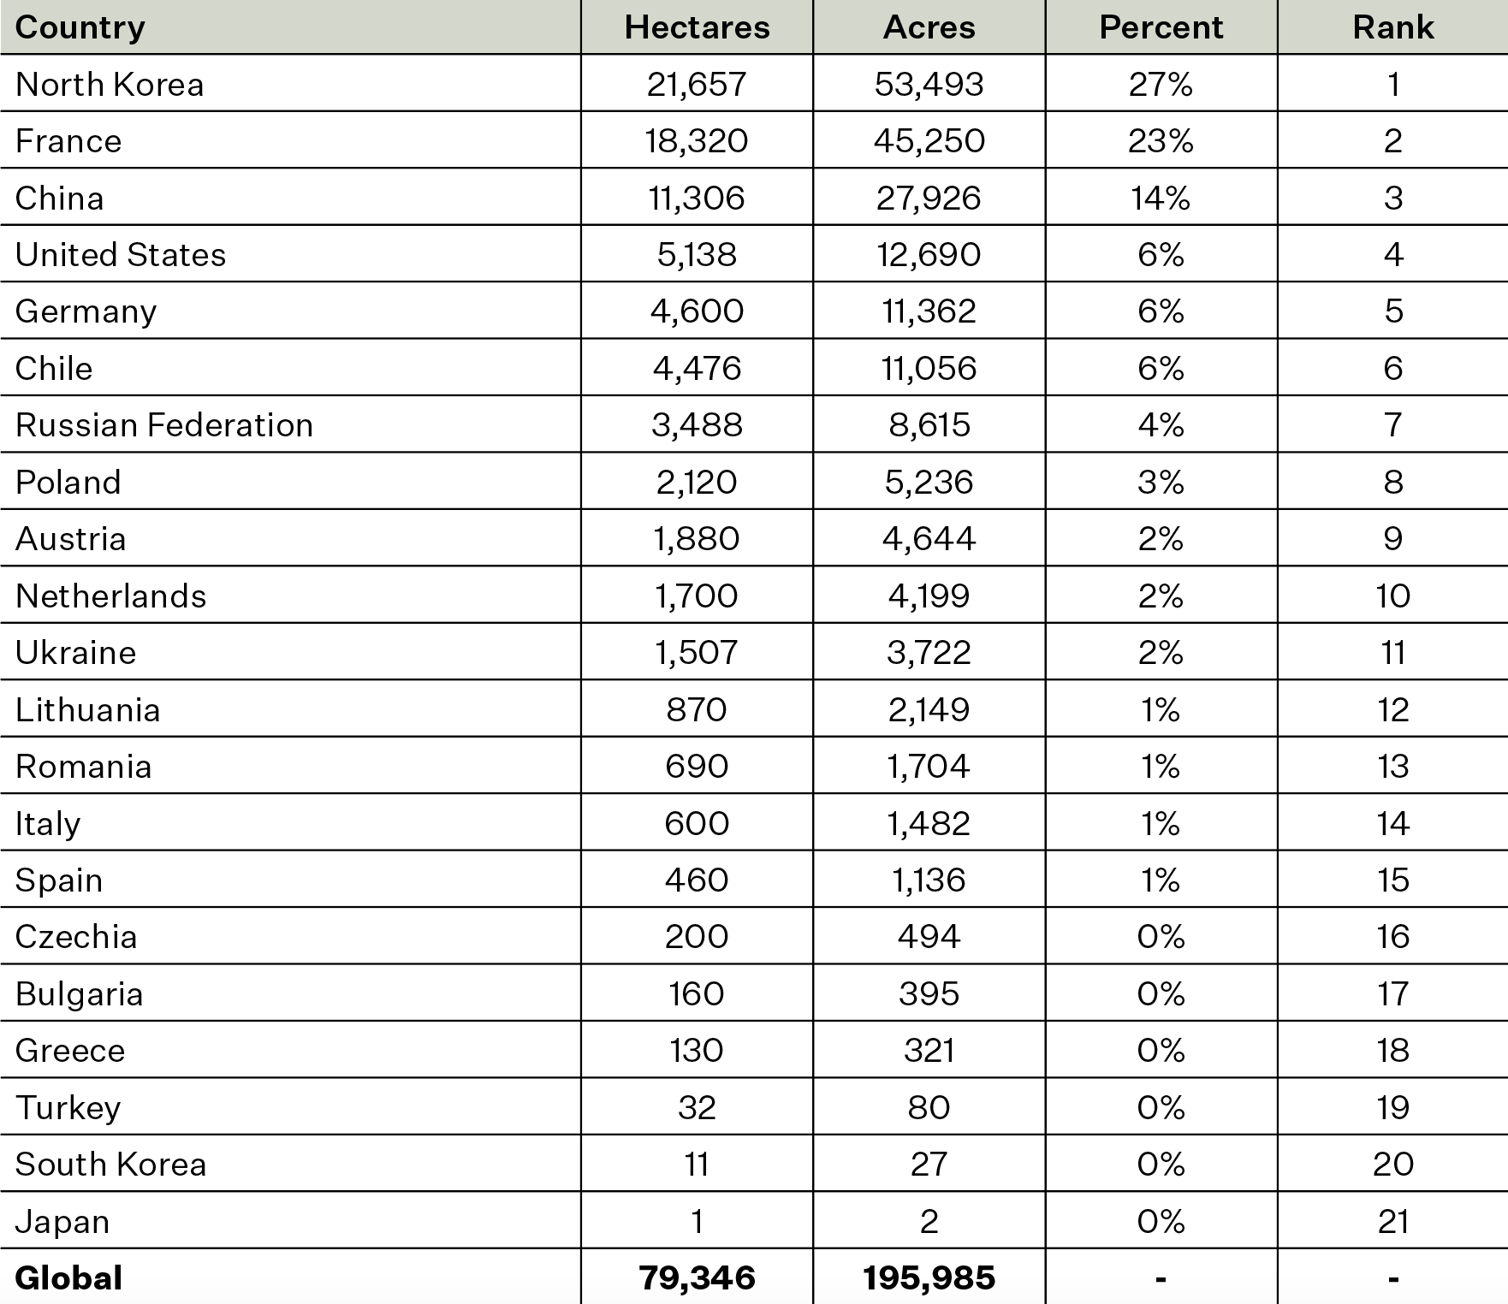
GLOBAL FIBER HEMP PRODUCTION By Area (2021)
2024 OSU HEMP WORKSHOP
Fiber hemp was grown on approximately 196,000 acres (79,000 hectares) globally.
Production by area was led by North Korea (27%), France (23%), China (14%), US (6.5%), and Germany (~6%).

Slide 10
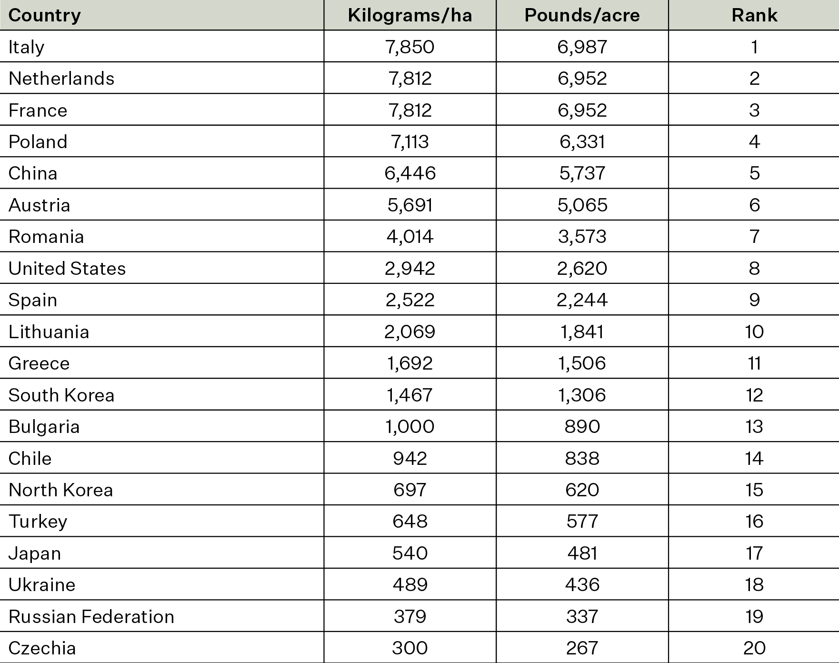
GLOBAL FIBER HEMP YIELDS (2021)
2024 OSU HEMP WORKSHOP
Fiber hemp production by yield was led by Italy, and followed by:
    The Netherlands
    France
    Poland
    China
    (Note – the US ranked 8th)
Yields ranged from a low of 267 lbs/acre (300 kg/ha in Czechia to 6,987 lbs/acre (7,850 kg/ha) in Italy.

Slide 11
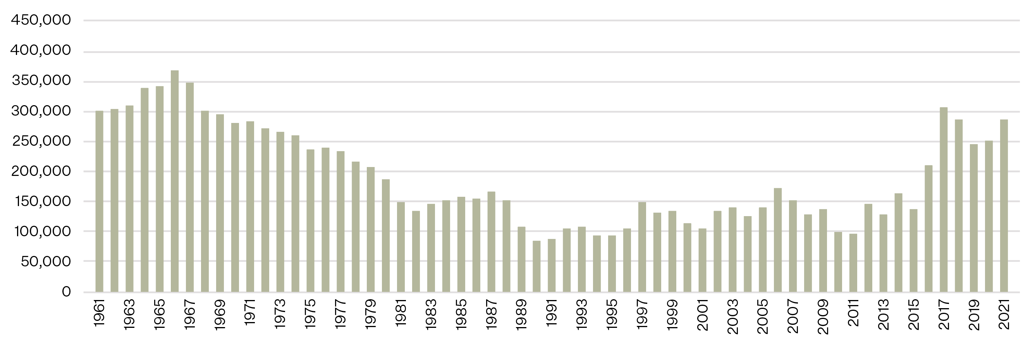
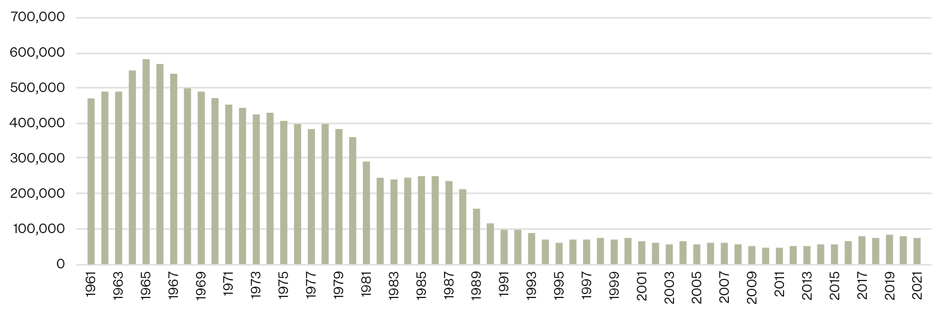
FAO GLOBAL FIBER HEMP PRODUCTION Over 60 Years (1961–2021)
2024 OSU HEMP WORKSHOP
Global fiber hemp production 1961–2021 by volume (tonnes)
After a low in fiber hemp production in the 1990’s, there has been an increase - though inconsistent – to 2021.
Total fiber hemp production was 4% more in 1961 than in 2021.
Fiber hemp was harvested from 84% less land in 2021 than in 1961 – BUT with 510% greater yield.
Global fiber hemp production 1961–2021 by area (hectares)

Slide 12
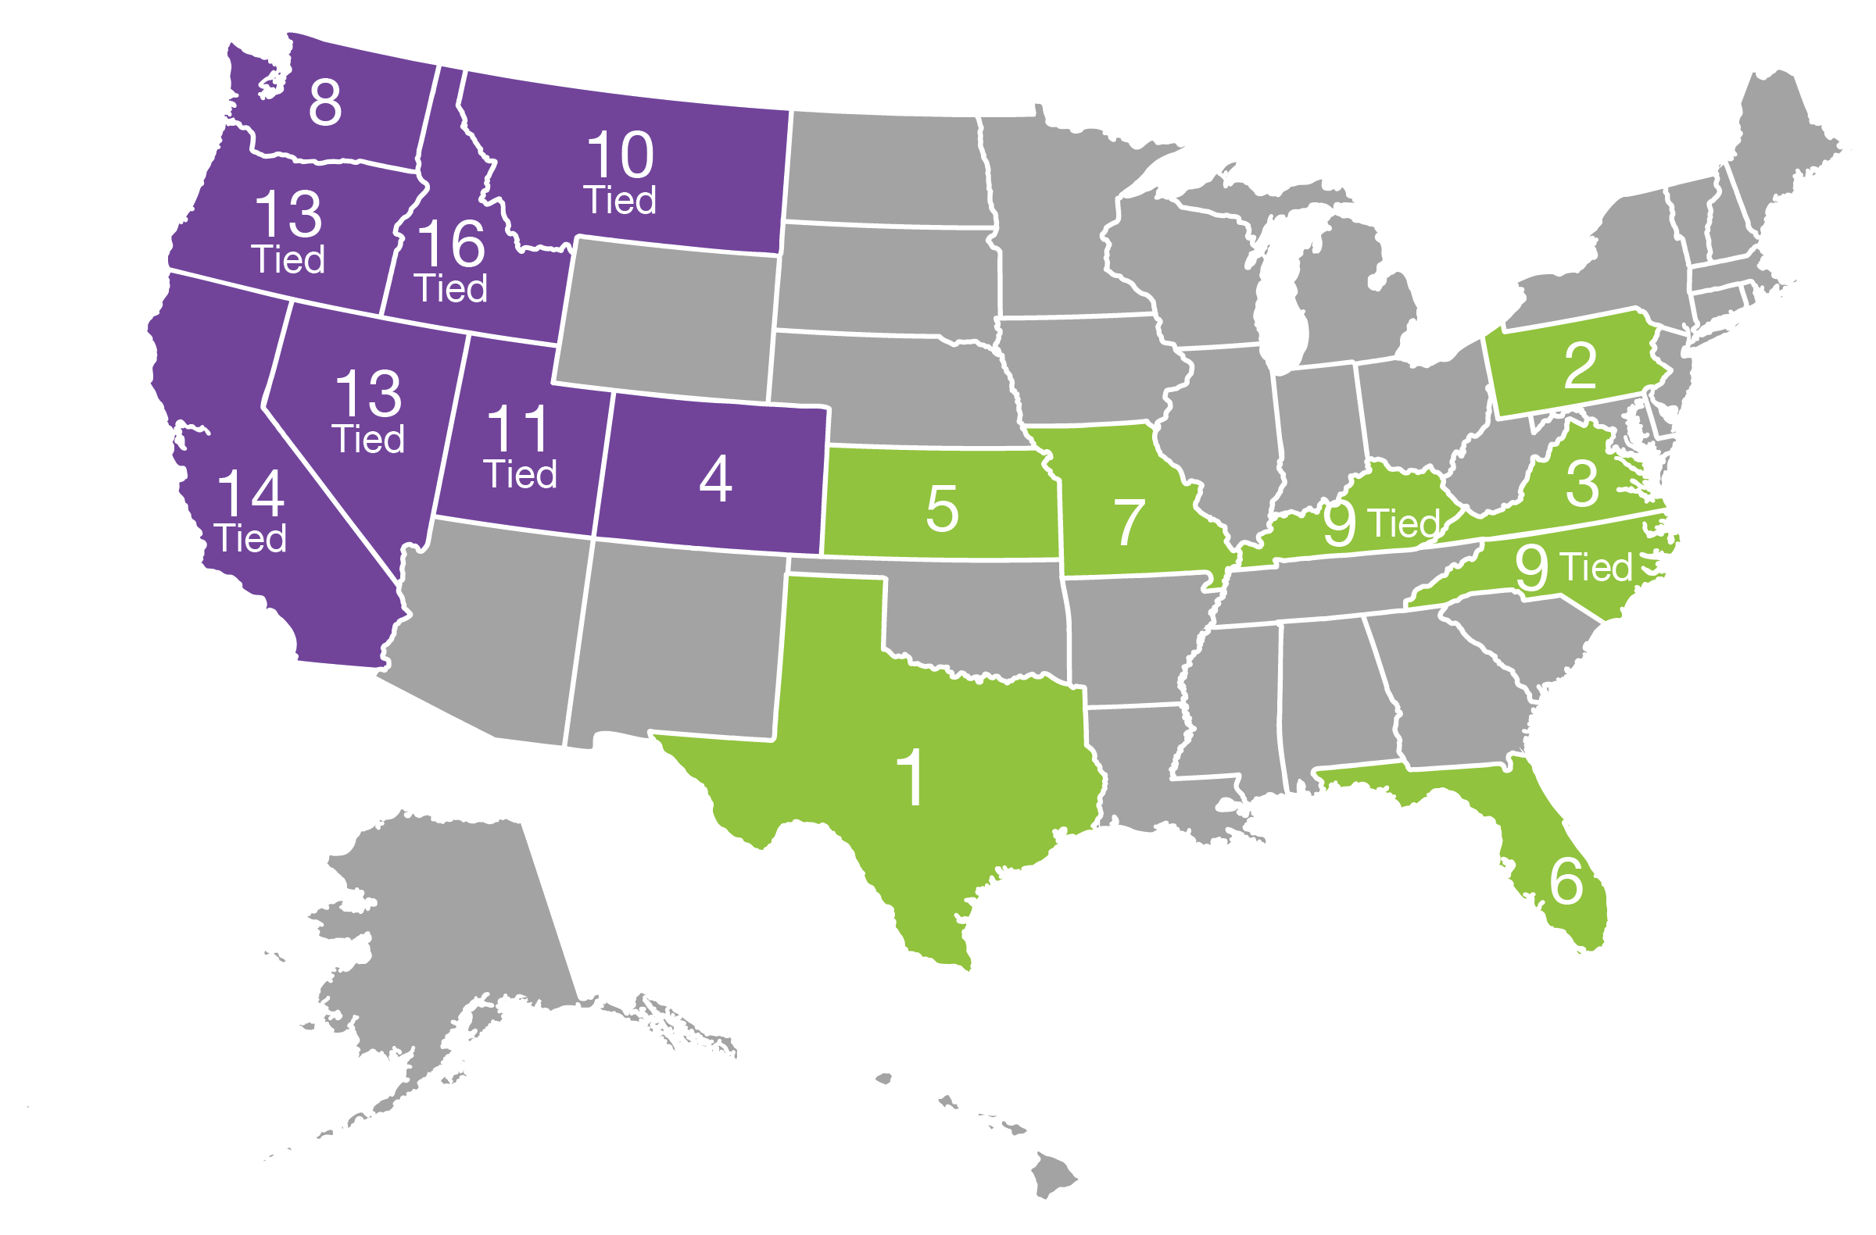
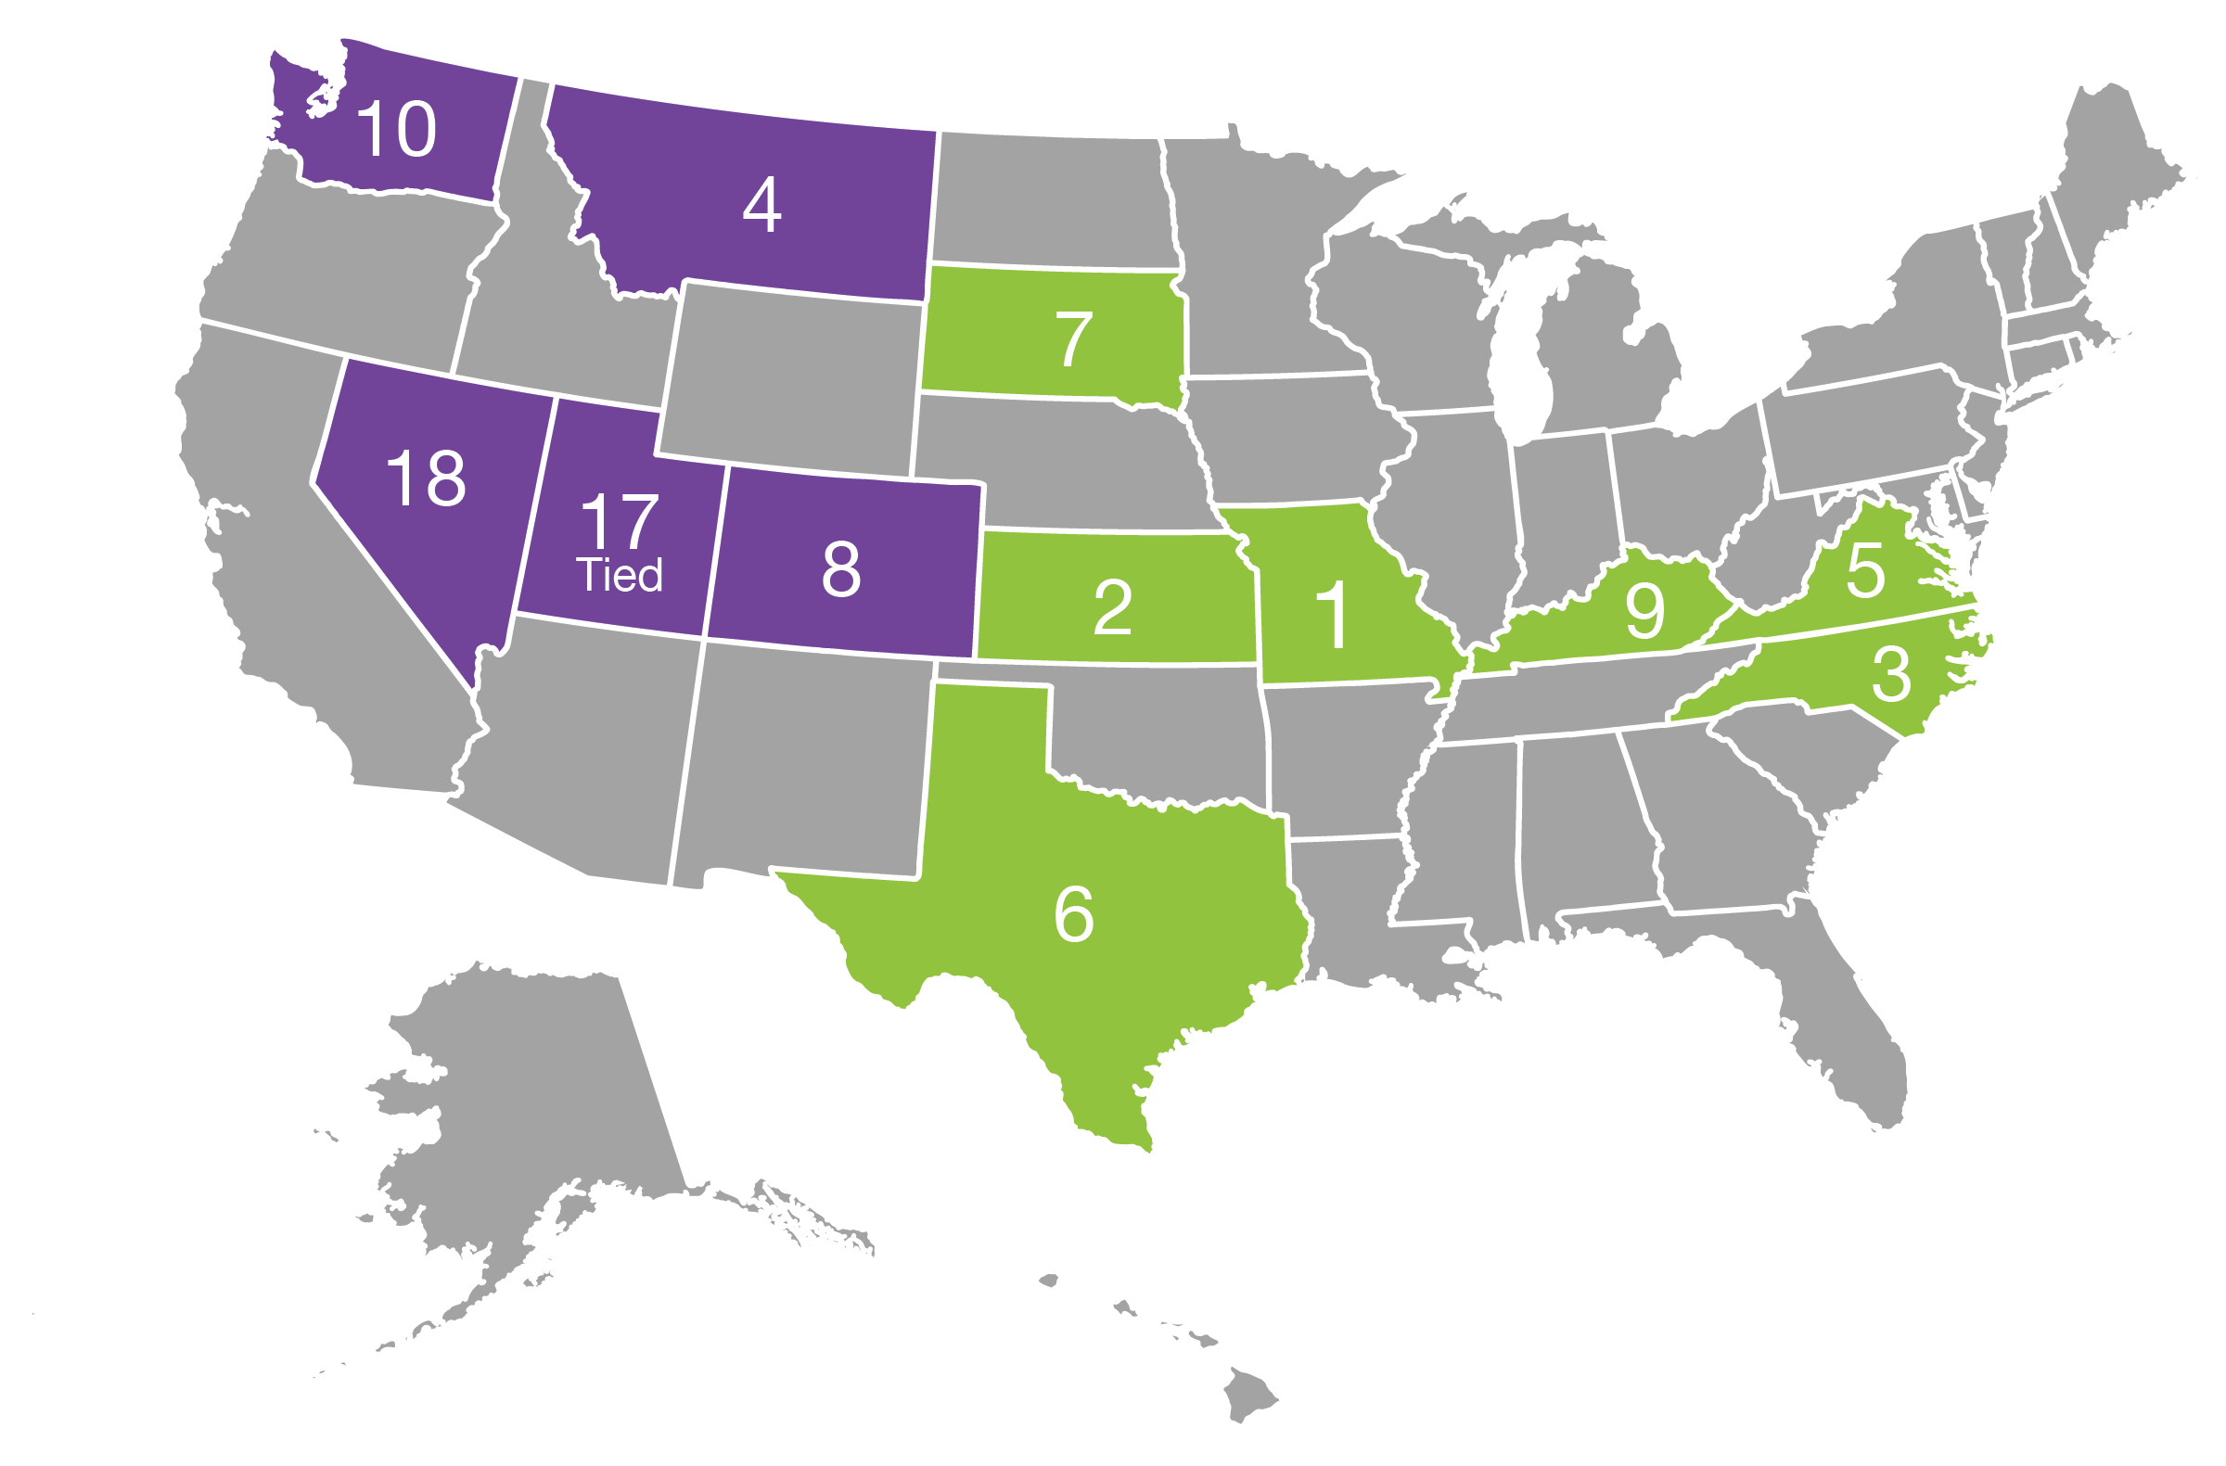
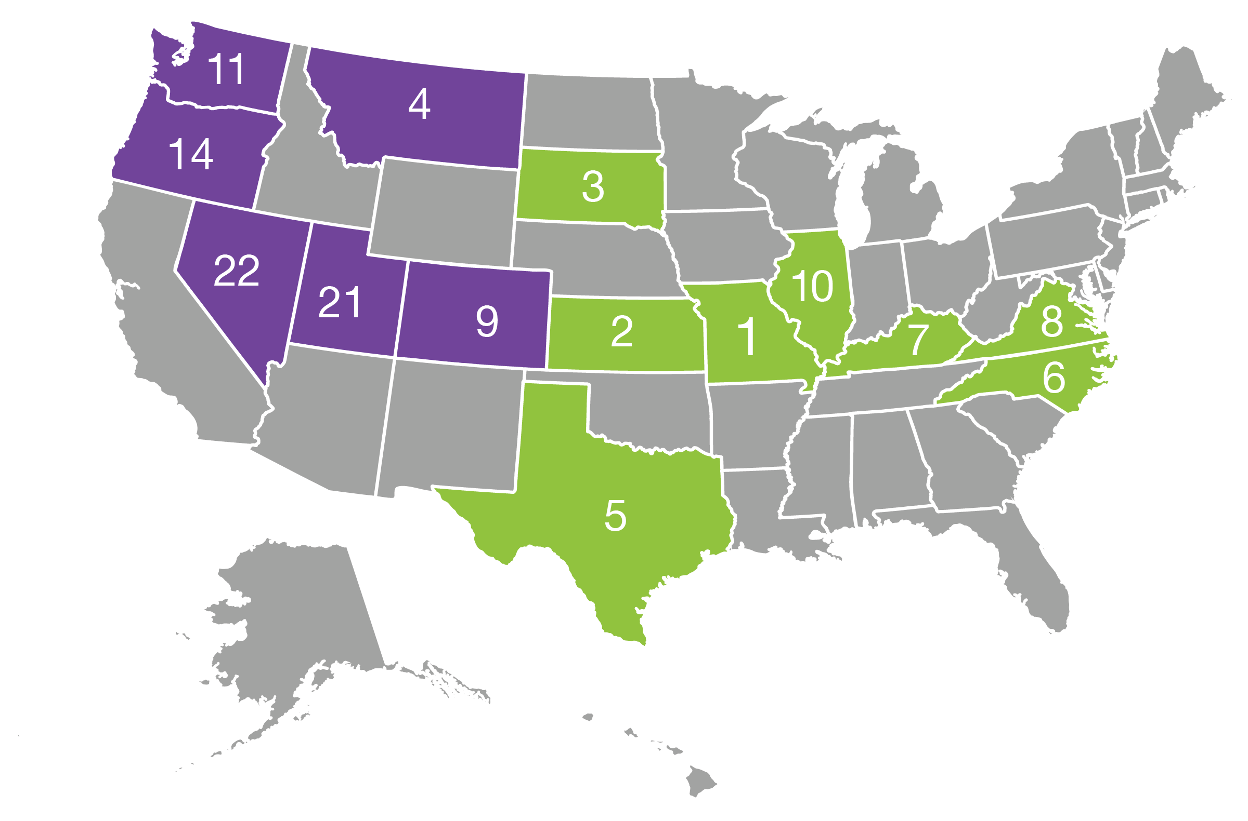
US AND NORTHWEST’S ROLE in 2022 US fiber hemp production
2024 OSU HEMP WORKSHOP
TOP 10+ OF 24 STATES BY FARMS, ACRES, VOLUME DATA*
(Those with data in the West/NW are in purple)
Top 10 for number of fiber hemp farms
Top 10 for number of fiber hemp acres harvested
Top 10 for volume of fiber hemp harvested
In 2023: Plot sizes expanded => fiber plantings exceeded the 10,000-acre threshold for the first time since hemp’s legalization in 2018. (Harvested acreage data is not yet available.)
Planted acreage leaders: Montana, South Dakota, Idaho
* “Top 10+” means the Top Ten states plus those states in the West/Northwest for which data is available in the USDA 2022 Census of Agriculture.
Source: USDA
Notes:
SM – note that USDA only had Farms data for Idaho pre-2022. 2023 is from the 2023 Data from Montana MDA.
Note – Top 10 plus NW states noted.
California, Idaho,

Slide 13
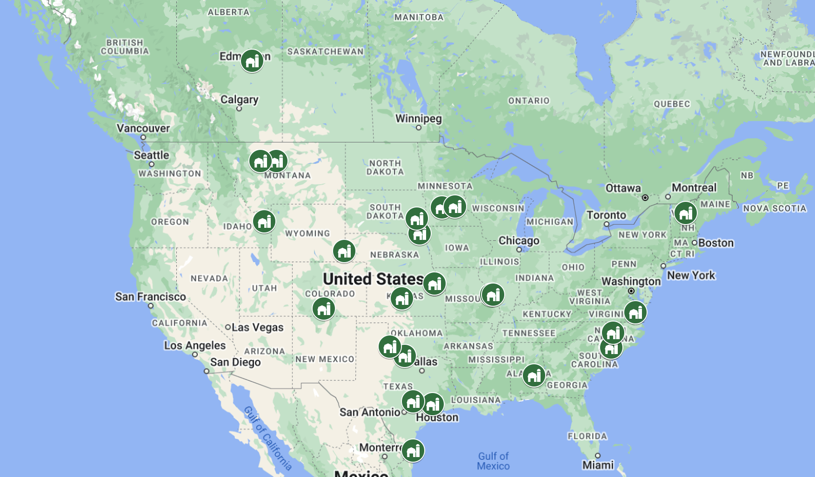
HEMP DECORTICATION IN NORTH AMERICA
2024 OSU HEMP WORKSHOP
2024 OSU HEMP WORKSHOP
Alberta,
Canada
Canadian Rockies Hemp Corp.
Kansas
Sound Bend
Industrial Hemp
Prairie Band Ag
Montana
IND HEMP
United Fiber Co.
Oklahoma
Western Fiber
Virginia
FyberX
Alabama
BastCore
Minnesota
Prairie Producers
Hemp Acres z
North Carolina
Biophil Natural
Fibers
NC State
South Dakota
Complete Hemp
Processing
Dakota Hemp
Vermont
The Zion
Corporation
24 decorticators in 15 states and Western Canada as of March 2024
Colorado
Global Fiber
Processing
Missouri
Tiger Fiber
Midwest Natural
Fiber
Idaho
Whitefield Global
Texas
Panda Biotech
Lone Star Industrial
Materials
Tetra Hemp
Environmental
Living Systems
Wyoming
Wyoming Hemp
Company
Credit: Eric Singular

Slide 14
BENEFITS OF HEMP
2024 OSU HEMP WORKSHOP
No-to low Input: Few pesticide registrations globally
Beneficial to bees and biodiversity in general; No-low inputs = no-low exposure
Tap roots improve soil health, prevent erosion
Effective for phytoremediation (chemicals, metals, radiation)
Could replace fossil fuel-based synthetic textiles such as polyester.
Multi-purpose crop with fiber and oilseed as co-products from a single crop / additional revenue stream.
Beneficial rotational crop: Increased weed suppression and yields in crops grown after hemp
Photo: Sandra Marquardt

Slide 15
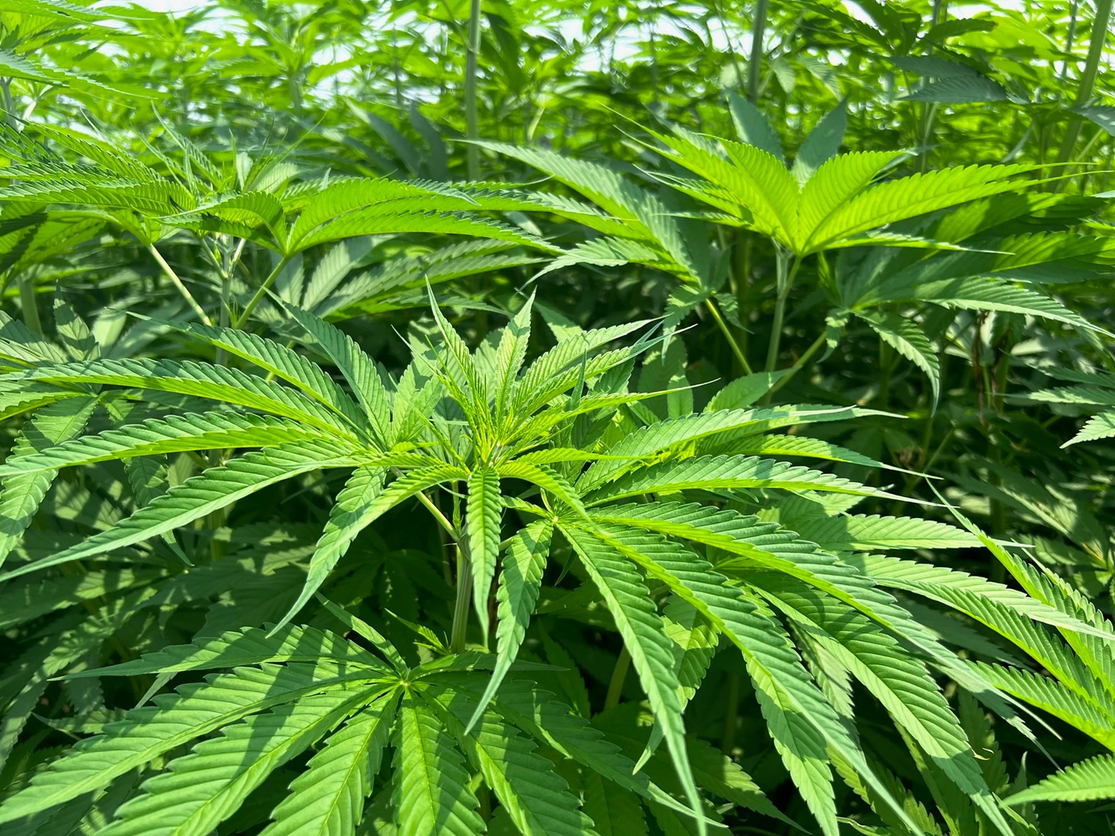
2024 OSU HEMP WORKSHOP
CONCERNS AROUND
HEMP
Availability and use of synthetic pesticides on fiber hemp is likely to expand without commitment to/ research into no-to-low chemical pest management methods.
Hemp has high fertilization needs, posing risks to air and water if synthetic fertilizers are the choice. Fertilizer production is also highly energy intensive.
Greenhouse gas emissions from hemp production may increase further with increased mechanization, mostly fossil fuel-based.
Need for respect of the human rights and wellbeing of all individuals involved, and production for textiles should not undermine food security.
Unsubstantiated claims abound and should be substantiated or dropped.
Photo: Sandra Marquardt

Slide 16
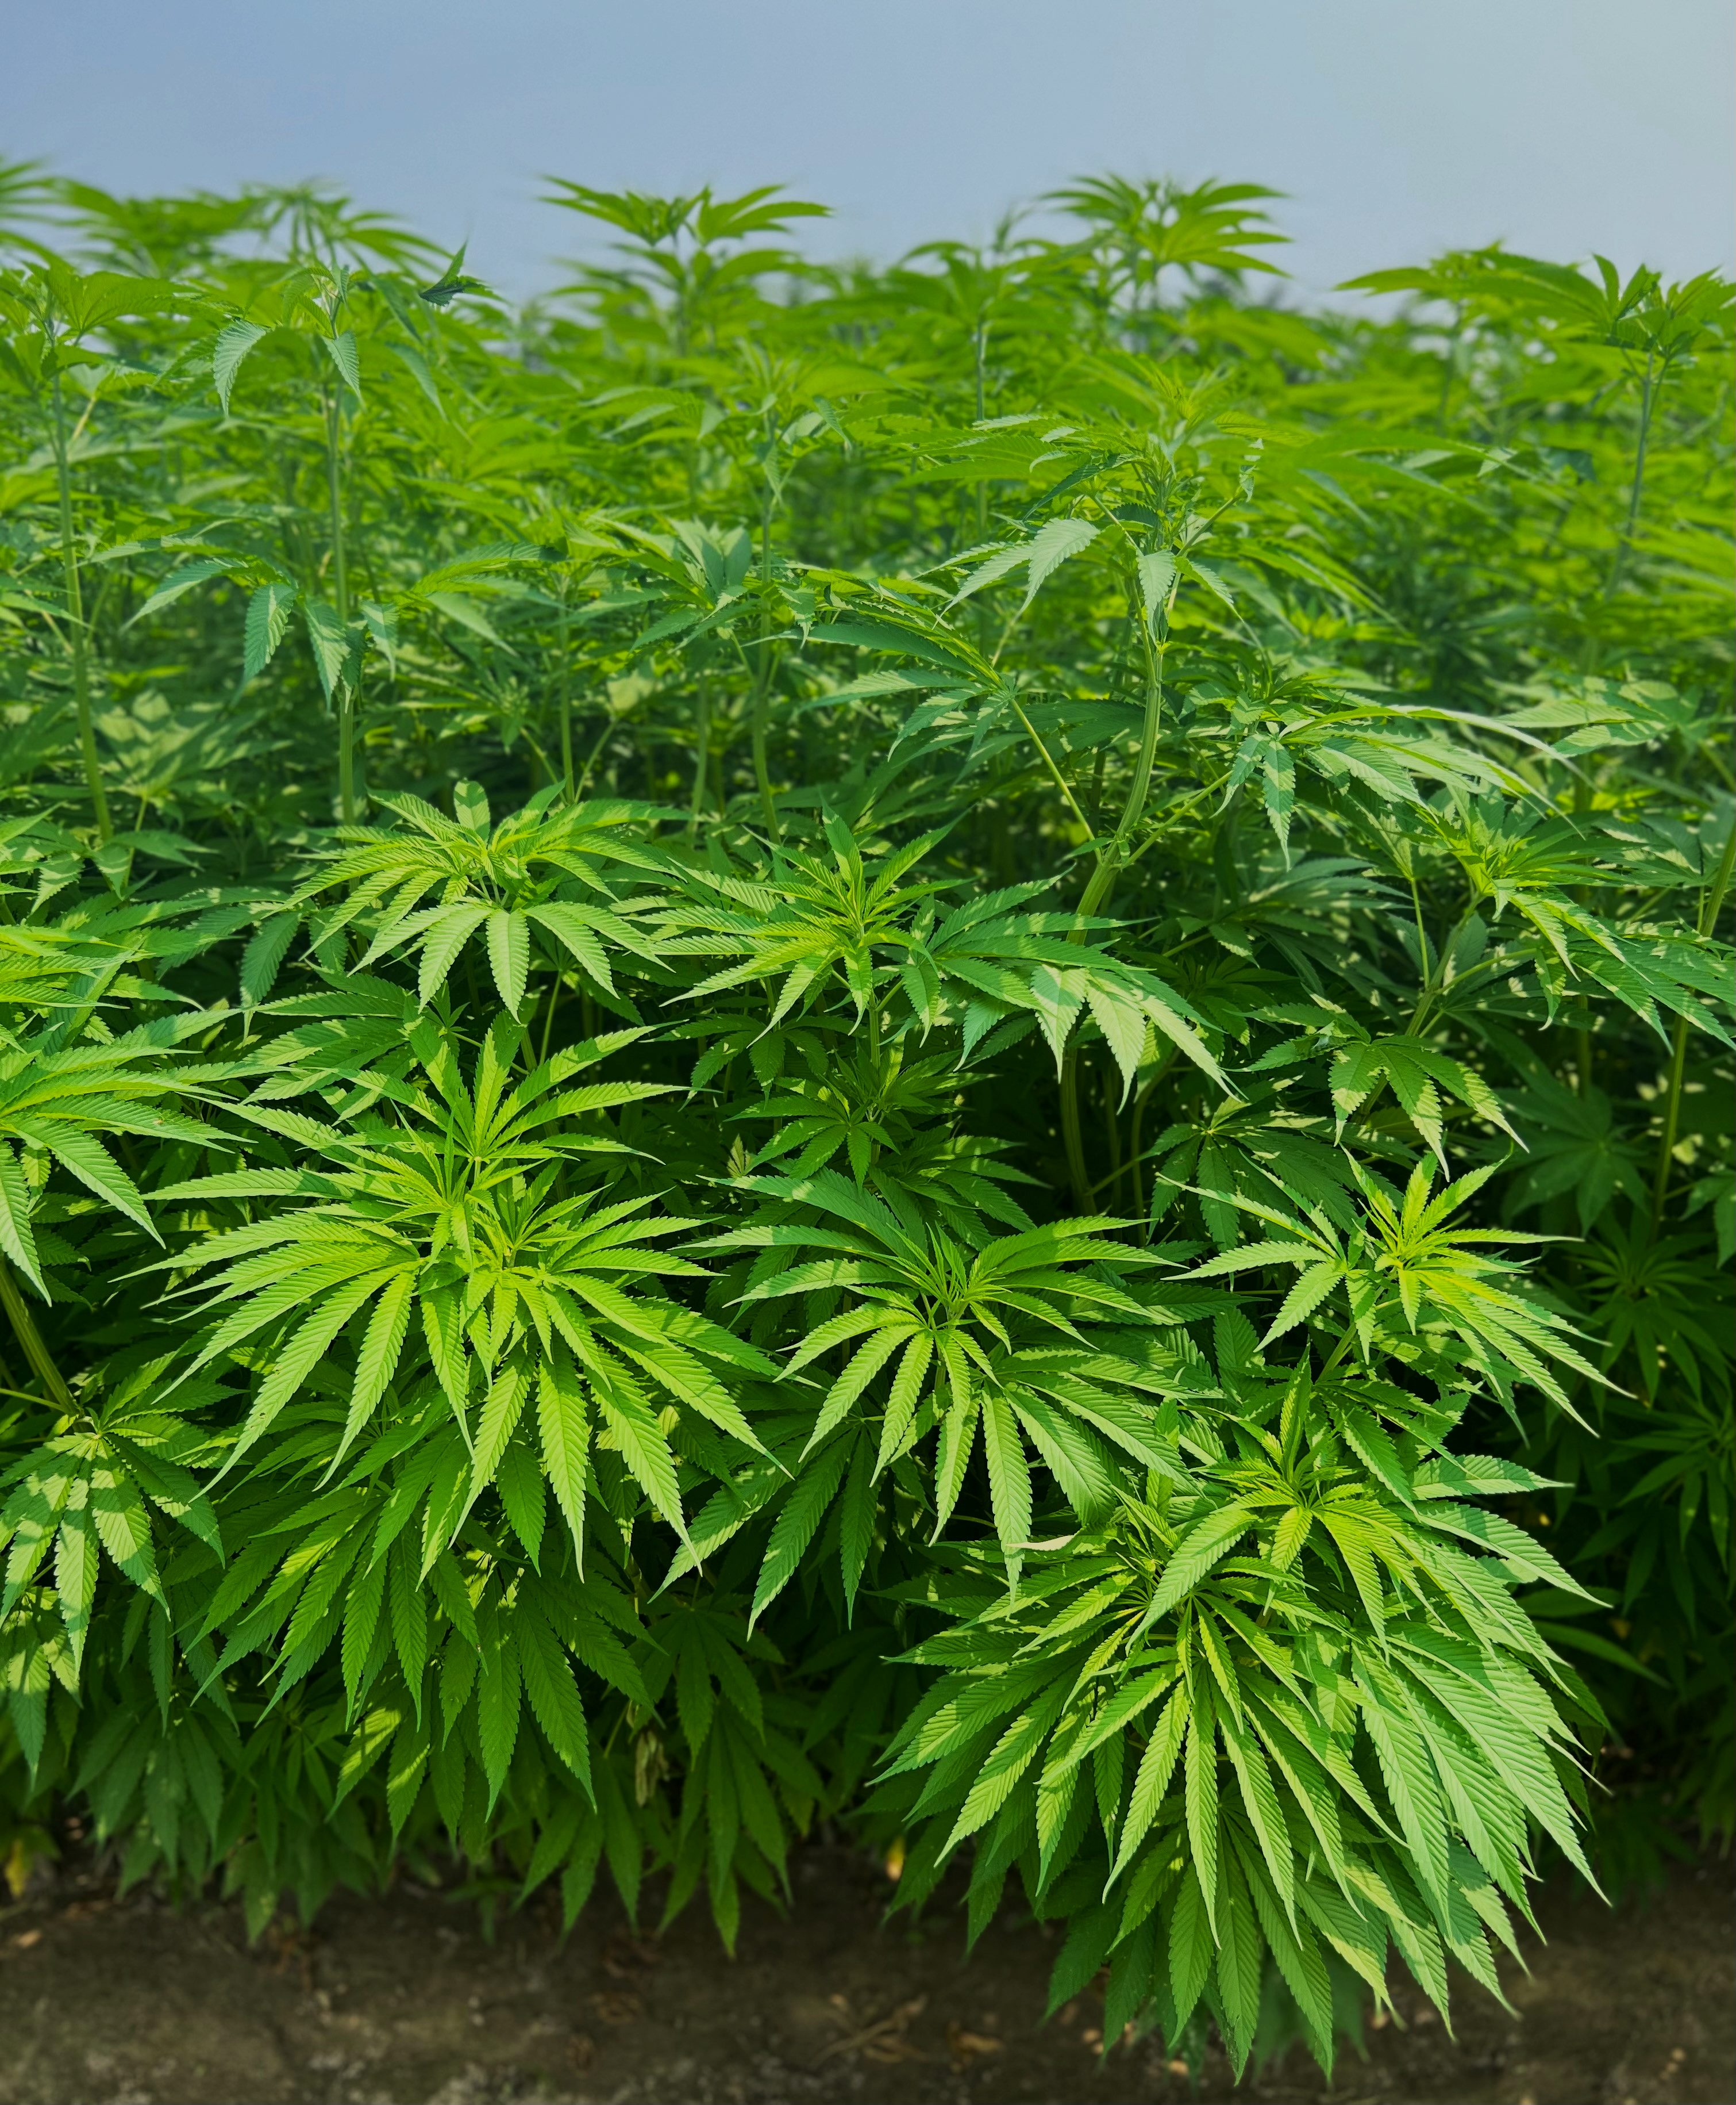
2024 OSU HEMP WORKSHOP
PESTICIDE USE
ON HEMP
Pesticides (herbicides, insecticides, fungicides, etc.):
Can cause cancer, birth defects, wildlife harm, air and water contamination, and more.
Few pesticides are registered for use on hemp currently.
China and Turkey: None - UK: One
US permits approximately 45 biological active ingredients (AI) and only one conventional AI - ethalfluralin (Sonalan).
More pesticides could become registered.
Universities are researching the use of numerous conventional pesticides already registered for other crops.
The Netherlands: Permits 25 active ingredients: ¼ are Highly Hazardous Pesticides (HHP) including glyphosate (Roundup™).
Photo: Sandra Marquardt

Slide 17
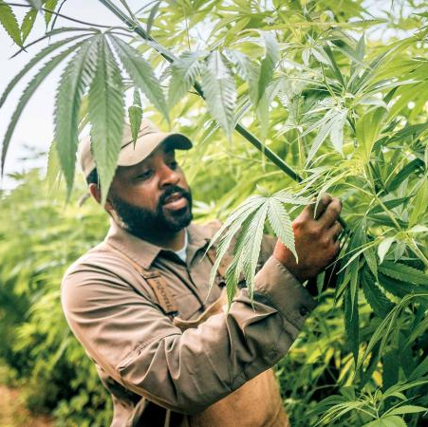
2024 OSU HEMP WORKSHOP
RICK BROWN, HEMPFINITY
“
We’ve chosen to grow our hemp in an organic and regenerative fashion.
We look at weeds and pests and figure out how to grow hemp in a way that prevents problems without the use of synthetic pesticides and fertilizers and with growing healthy soils and communities.
”
– RICK BROWN, HEMPFINITY

Slide 18
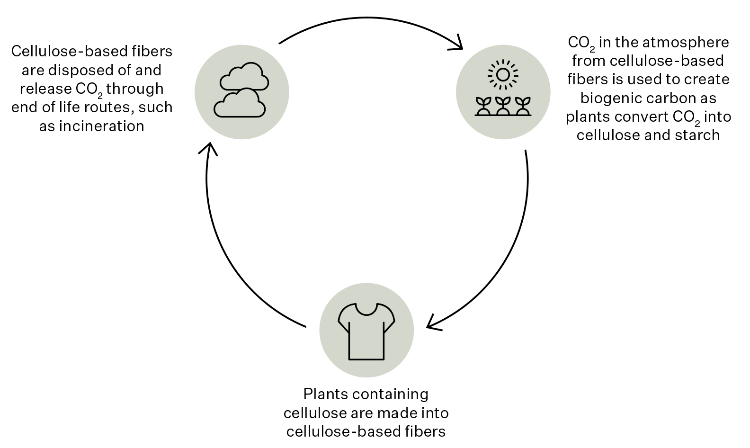
FIBER HEMP AND CO₂ SEQUESTRATION CLAIMS
2024 OSU HEMP WORKSHOP
According to LCA accounting rules it is not possible to account for carbon sequestration if the carbon is sequestered for less than 100 years.
More guidance is needed for the hemp and the overall fiber and material industry regarding how to account for soil carbon sequestration. Once finalized, the GHG Protocol Land Sector Removals Guidance will provide methods for accounting for land sector carbon removals from systems such as hemp cultivation.
So at this time, it is not possible to include carbon sequestration in natural fibers, including hemp fiber, when calculating GHG emissions for natural fiber textiles.
(Nor acceptable to make such claims in promotional media which could lead to “greenwashing” concerns.)
Image: Textile Exchange

Slide 19
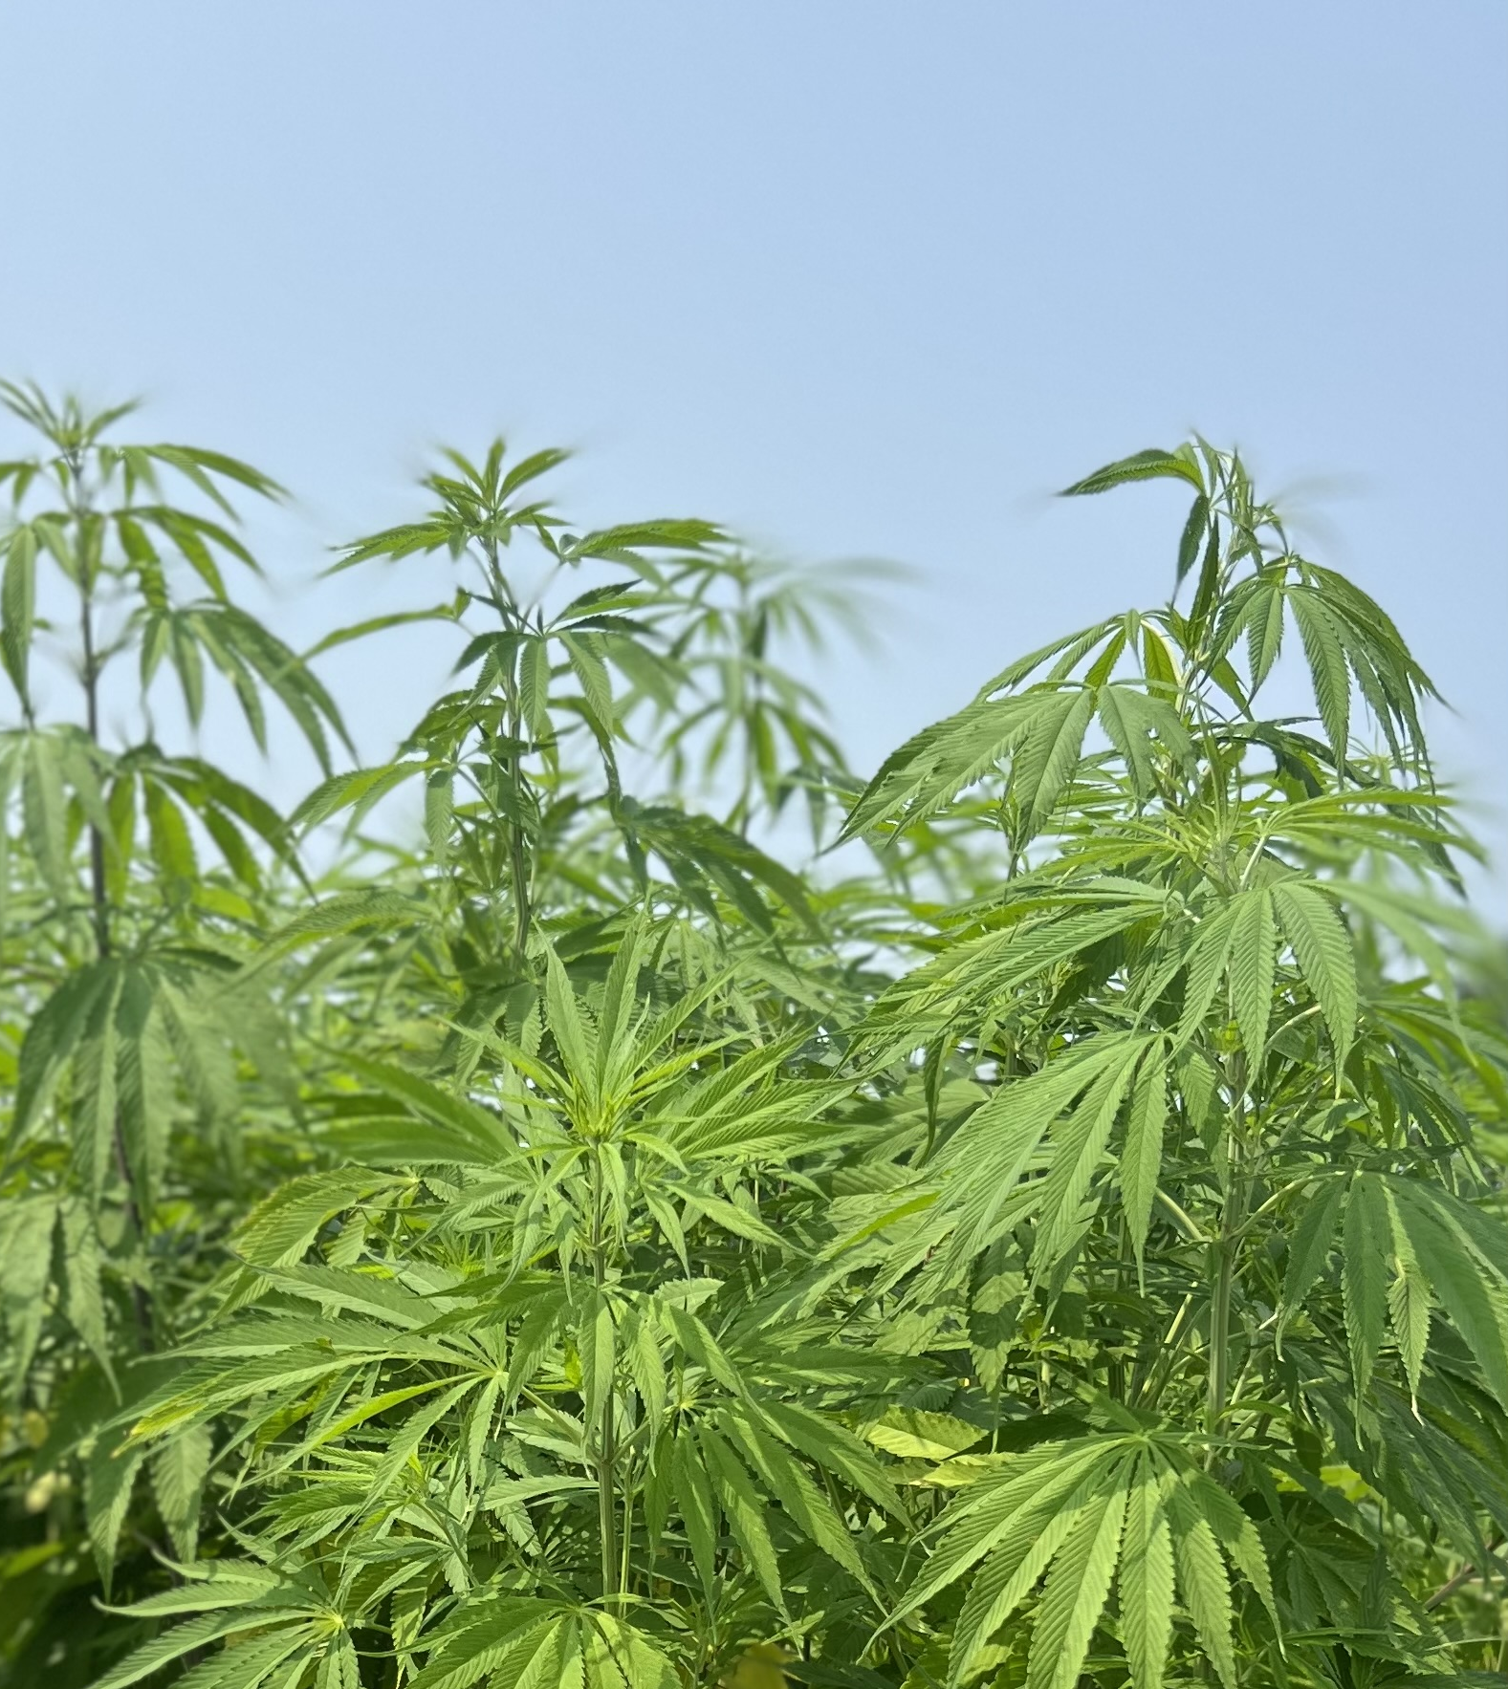
2024 OSU HEMP WORKSHOP
FIBER HEMP
PRODUCTION
STANDARDS
Several production standards are already in place that address a variety of topics including pesticide and fertilizer use, water use, greenhouse gas mitigation, soil health, biodiversity, land use change, as well as human rights.
Organic
Regenerative Organic Certified
ISCC (International Carbon and
Sustainability Certification)
INCCert: Developing the Responsible Hemp Standard. Focus is on hemp fiber farming practices (water use, pesticides, fertilizers, etc.), and supply chain traceability. Being piloted in the U.S., Europe, and Latin America.
ASTM and the Federation of International Hemp Organization (FIHO) in March 2024, inked an agreement to create a portfolio of hemp-related standards similar to those for cotton.
NOTE: Claims supporting “regenerative” production – other than “regenerative organic” - are largely unverified and not outcome- or measurement-based at this time.
Photo: Sandra Marquardt

Slide 20
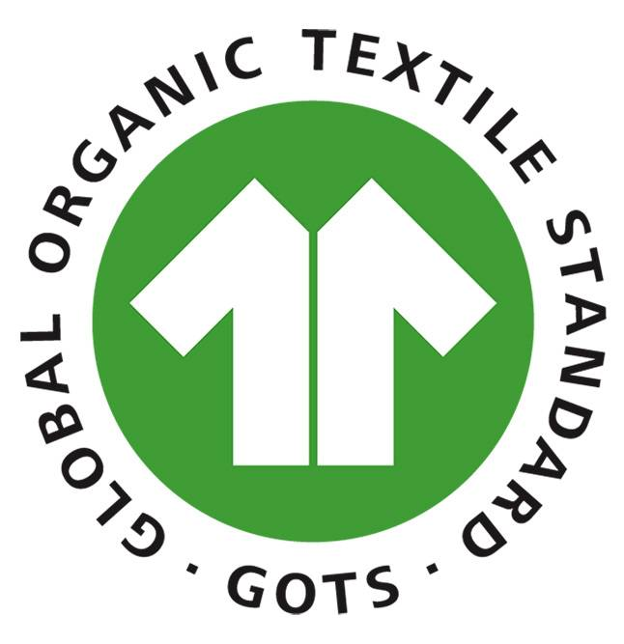
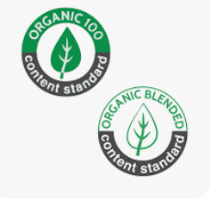
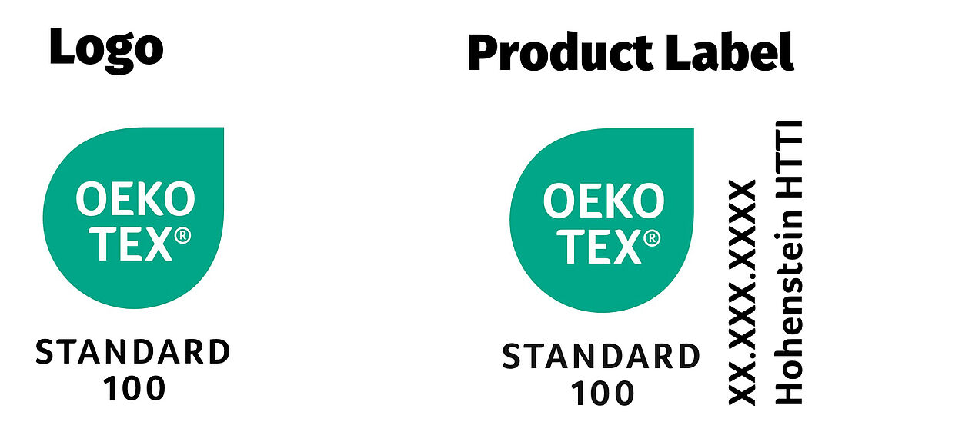
POST-HARVEST FIBER HEMP STANDARDS
2024 OSU HEMP WORKSHOP
Textile Exchange Organic Content Standard:
  5-100% organic content traceability
B. Global Organic Textile Standard:
A minimum of 70% organic or transitional fiber (such as hemp)
Addresses the processing and manufacturing of textiles re environmental plus social criteria.
C. OEKO-TEX® STANDARD 100 (also available as OEKO-TEX® ORGANIC COTTON):
Products are tested for GMOs, pesticides, and toxic substances.

Slide 21

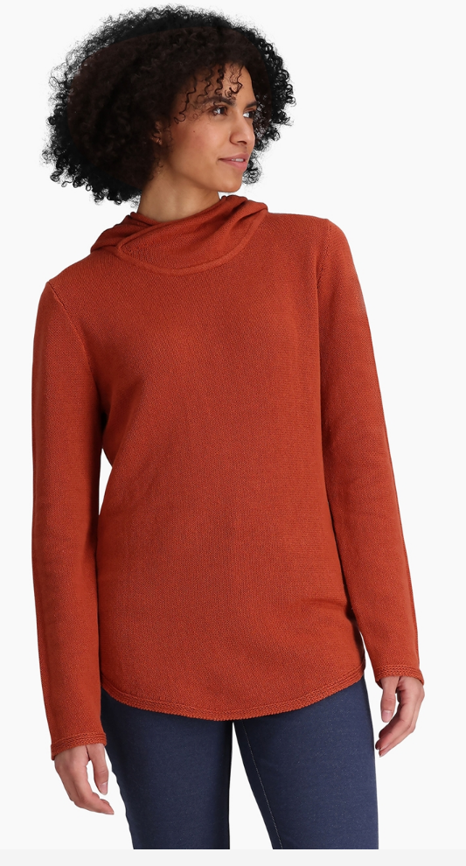
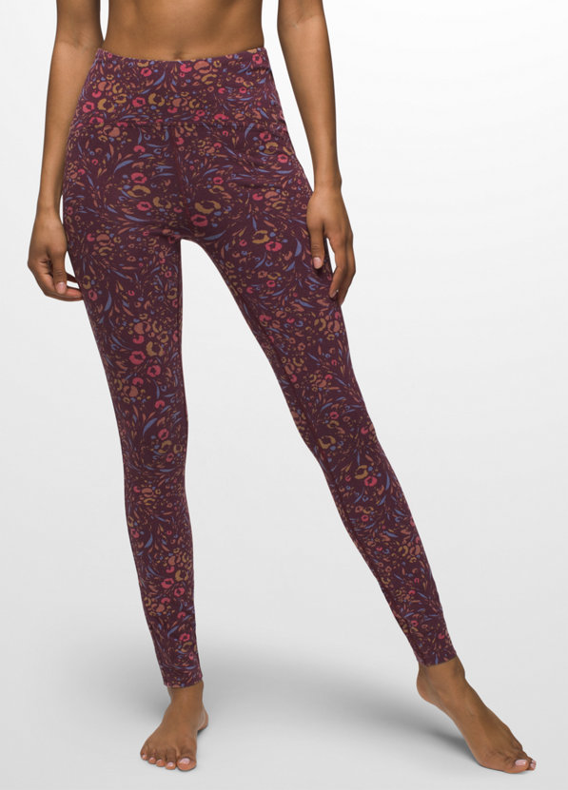
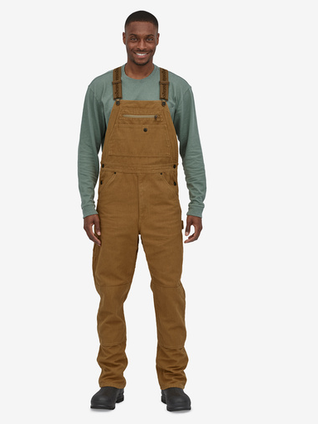
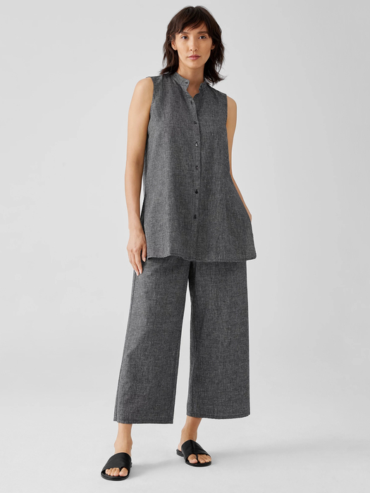
HEMP IN APPAREL TODAY (1)
2024 OSU HEMP WORKSHOP
Jungmaven
Royal Robbins
Prana
Patagonia
Eileen Fisher
Clothing
increasingly used in casual, athletic, work wear, and outdoor wear.
Blends
Hemp can be used as 100% content or in combination with cotton, silk, and a variety of other fibers
and materials
Brands (pictured here)
Eileen Fisher
Jungmaven
Patagonia
Prana
Royal Robbins

Slide 22
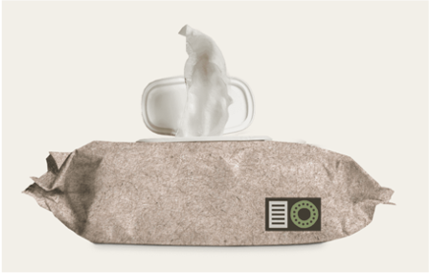
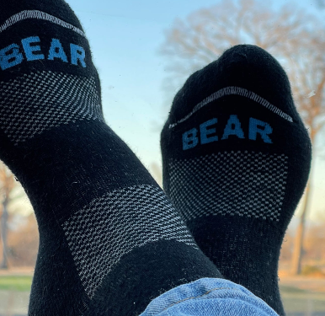
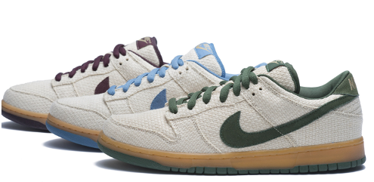
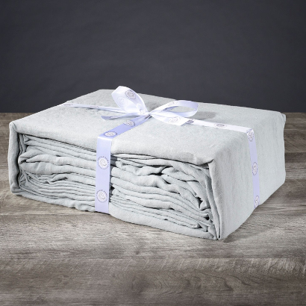
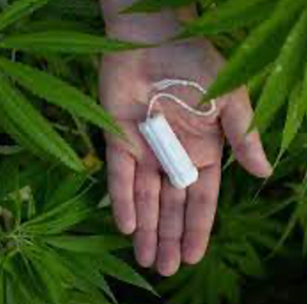
2024 OSU HEMP WORKSHOP
HEMP IN FOOTWEAR, HOME GOODS,
PERSONAL CARE PRODUCTS
Credit: Bast Fibre Technologies, Bear Fiber, Delilah Home, Nike Skateboarding, TraceFemcare

Slide 23
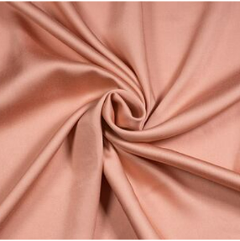
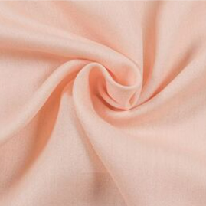
2024 OSU HEMP WORKSHOP
FIBER HEMP AS ALTERNATIVE FEEDSTOCK
FOR CELLULOSE-BASED TEXTILES
Opportunity
Use hemp fiber and hurd as a cellulosic feedstock for lyocell – such as wood for Tencel™ - as well as paper for packaging.
Fast-growing annual plants such as hemp (and flax and agricultural “waste”) could be used as a “tree-free” alternative pulp source.
Fewer steps than mechanical processing.
Lyocell process would use non-hazardous chemicals and a closed-loop system.
One pulp mill using hemp is located in Renton, WA; One using agriwaste: Los Angeles
Obstacle
Current hemp prices are higher than softwood chips.
Are brands willing to pay the higher price?
Images: Santor

Slide 24
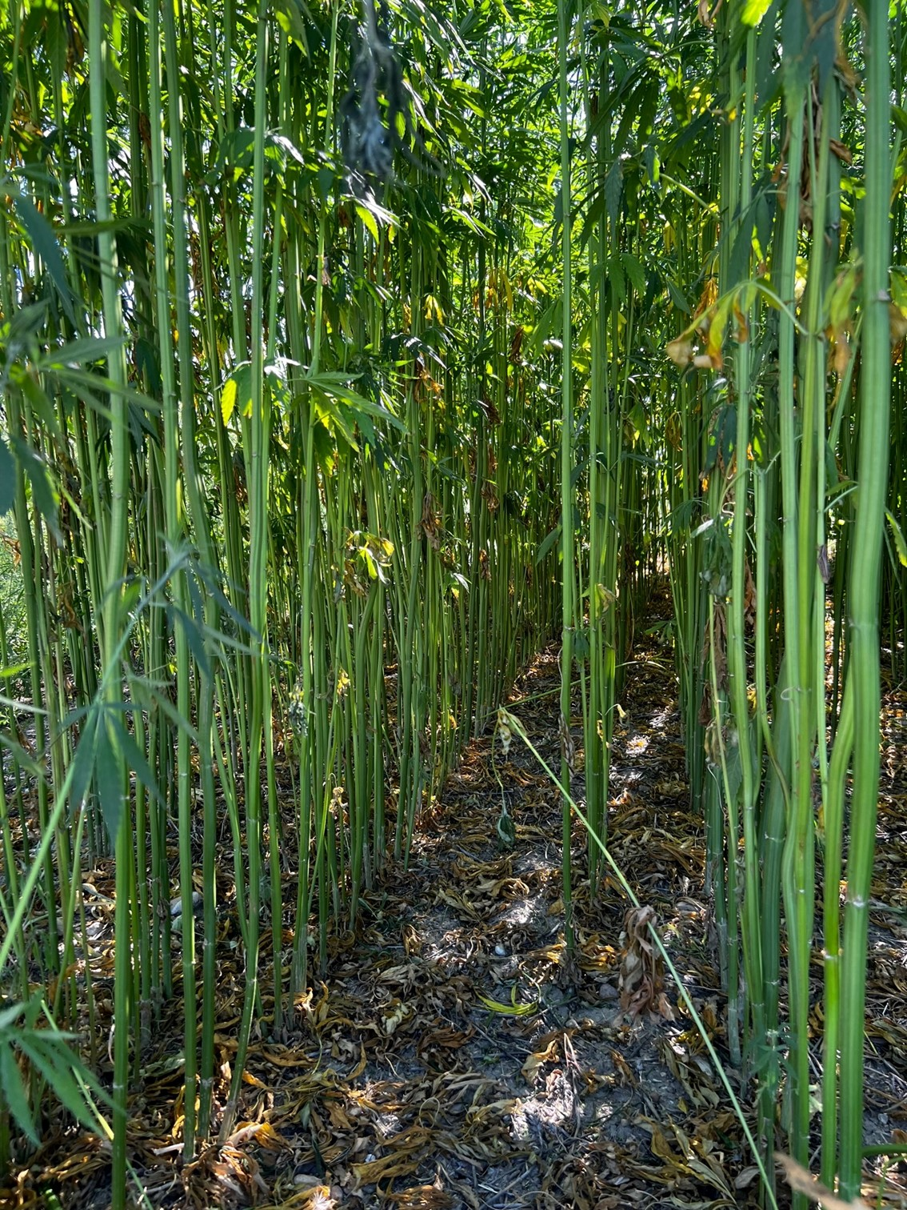
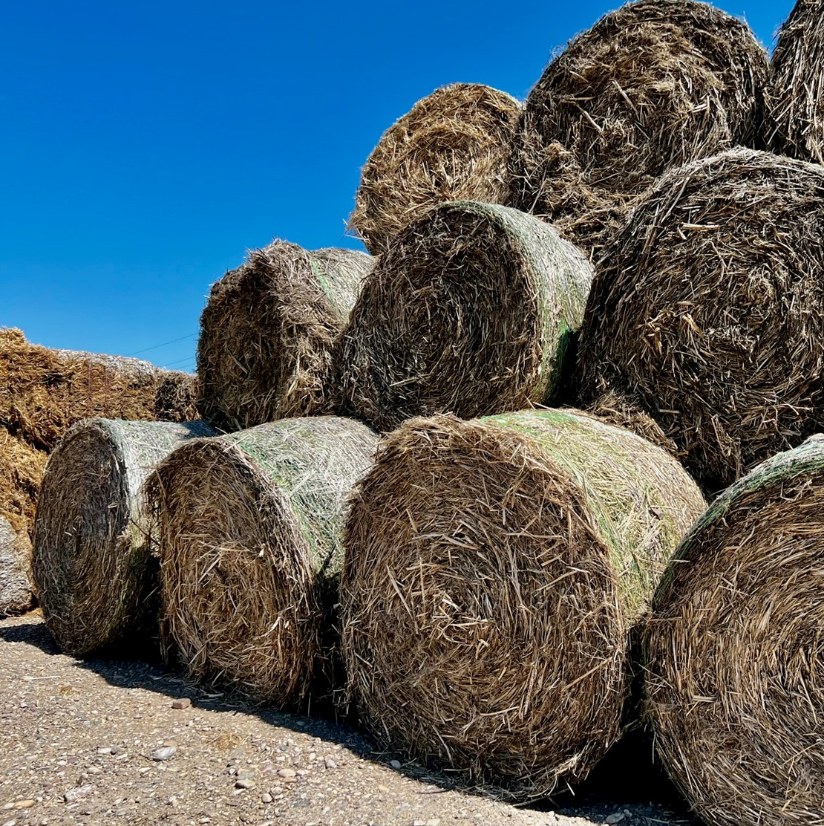
RECOMMENDATIONS
2024 OSU HEMP WORKSHOP
Governments, Brands
Promote the use of organic and outcome-based regenerative agricultural practices for hemp production.
Do not approve the use of synthetic pesticides – particularly the “Highly Hazardous Pesticides” - on hemp.
Become certified to standards addressing production and processing from field to final product.
Develop a US or regional supply chain and use renewable energy for processing stages in particular to minimize GHG emissions.
Adhere to human rights requirements globally. Don’t undermine food security.
NGOs/Academia:
Research, educate, and support organic and regenerative methods of hemp production.
Establish fertilizer recommendations prioritizing the use of compost, cover crops, and manure.
Research and address common but unsubstantiated claims.
Farmers:
Prioritize the use of organic and natural systems and biological inputs instead of synthetic ones.
Consumers:
Support companies sourcing from organic and outcome-based regenerative hemp programs – preferably certified to a standard.

Slide 25
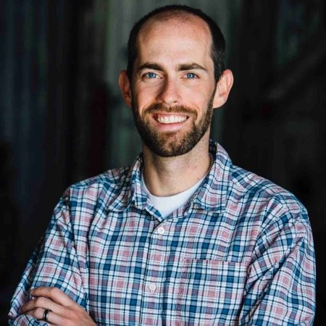
2024 OSU HEMP WORKSHOP
MATT DWYER, PATAGONIA
“
With hemp production, the textile industry needs to apply hindsight as foresight.
We must learn from the pesticide and fertilizer, water, biodiversity, and energy issues we’ve faced with other fibers and apply that knowledge to prepare for the future.
”
– MATT DWYER, PATAGONIA

Slide 26
THANK YOU
SANDRA MARQUARDT
ON THE MARK CONSULTING
WWW.ONTHEMARKCONSULTING.INFO

